Slide 1
Matter
Physical and chemical properties

Slide 2
States of Matter
There are four states of matter:
Solid: Definite Shape/Volume
Liquid: Definite volume, shape changes to container
Gas: volume and shape changes to container
Plasma: Formed under high temperatures when electrons leave the electron cloud. Found in sun, stars, lightning. Most common form of matter in the universe.

Slide 3
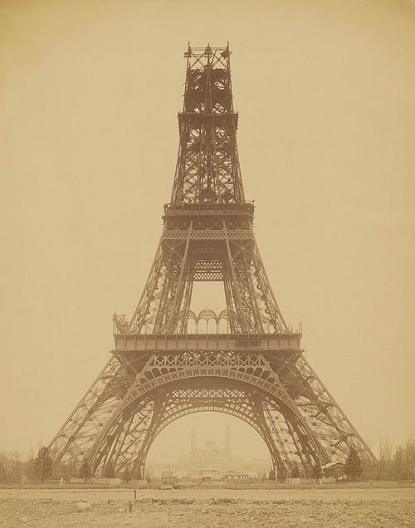
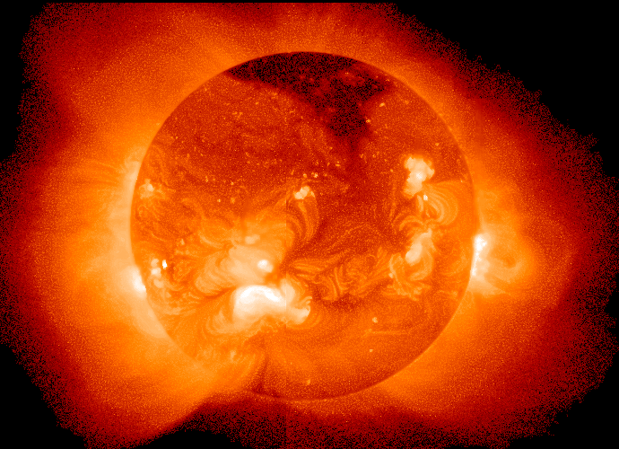
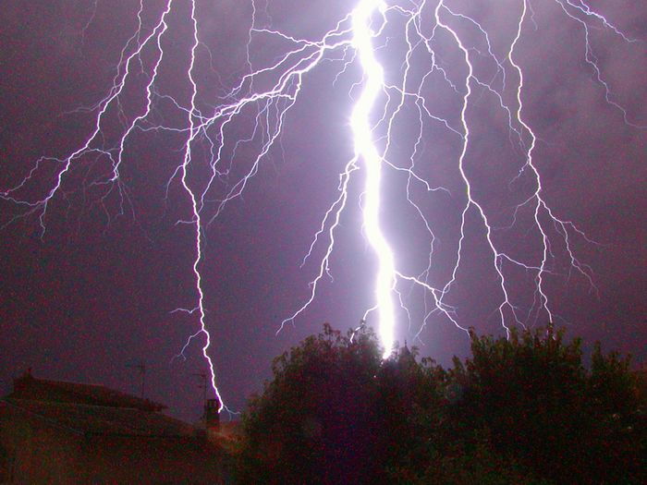
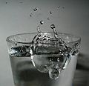

Slide 4
When the state of Matter changes…
A liquid will become a solid at its freezing point. The freezing point of water is 0°C.
A liquid will become a gas at its boiling Point. The boiling point of water is 100°C.
The Celsius degree scale was set up based on the boiling point and freezing point of water.

Slide 5
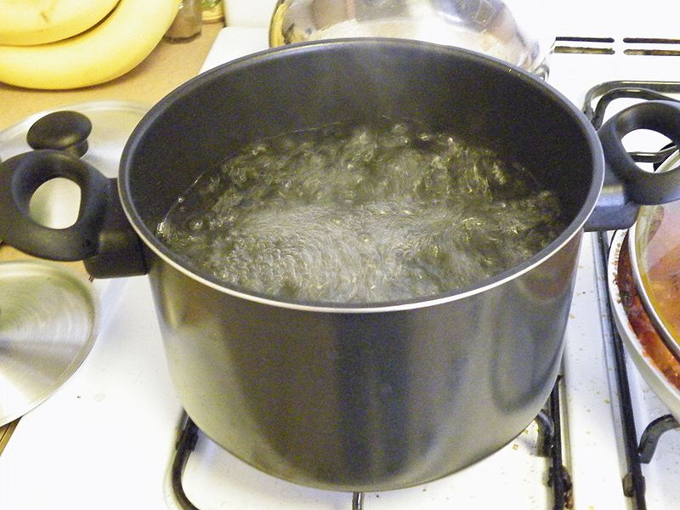
Phase change
When matter goes from one phase to another, its chemical properties do not change, but its physical properties do change.

Slide 6
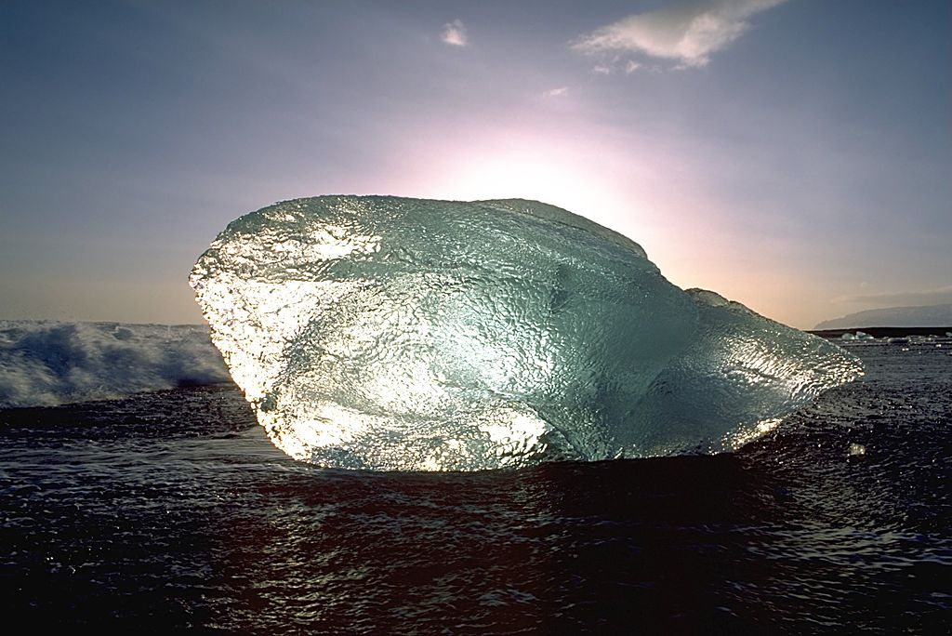
Water
Example: When water freezes and becomes ice, it still has the same chemical properties, but its physical properties have changed. It is now a solid with a lower density. This is why ice floats.

Slide 7
Physical vs. Chemical Changes
A physical change is a change in the physical form of something. You can easily get back what you started with.
A chemical change is a change in the chemical structure of one or more substances. You cannot easily get back what you started with.
If a new substance has formed, a chemical change has occurred.

Slide 8
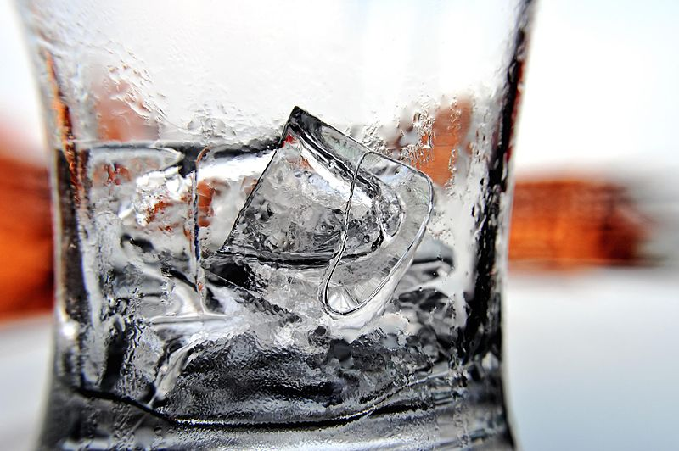
Examples of Physical Changes
A change in the state of matter is a physical change. You can easily melt an ice cube back into water.

Slide 9
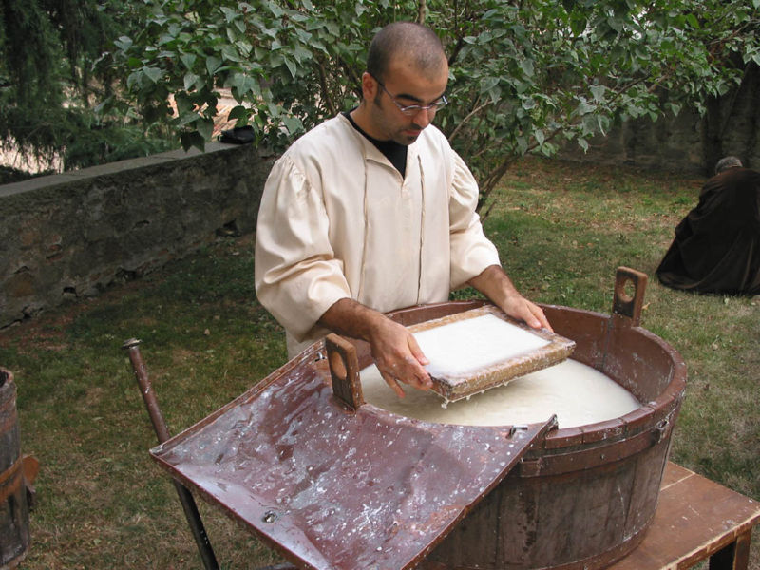
Physical changes
If you rip up a piece of paper…it’s still paper. It’s physically different, but it’s still paper. This is an example of a physical change.

Slide 10
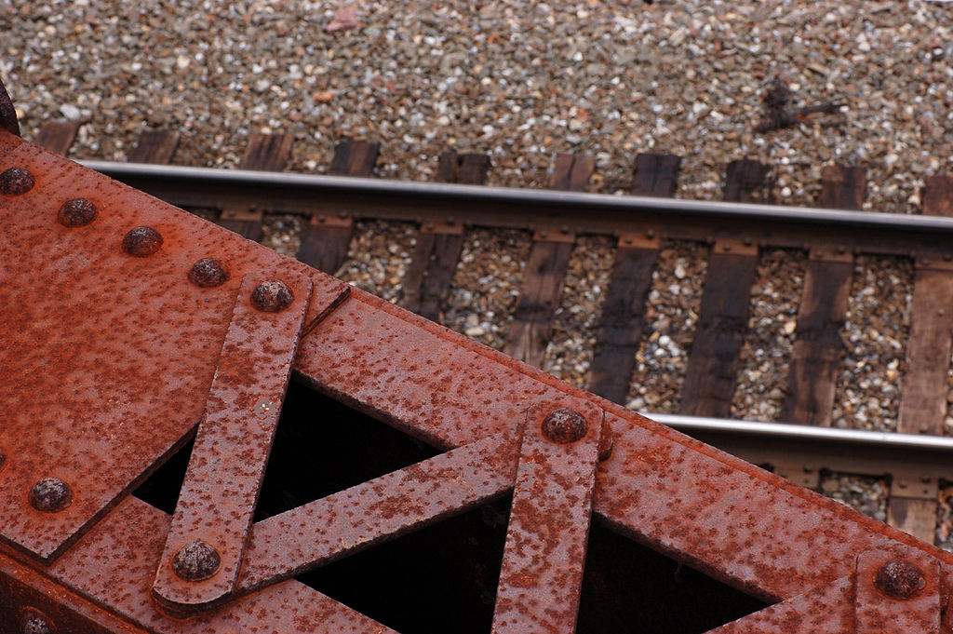
Examples of Chemical changes
Metal rusting is an example of a chemical change. You can remove the rust from the metal, but the rust is still rust. A new substance is created.

Slide 11
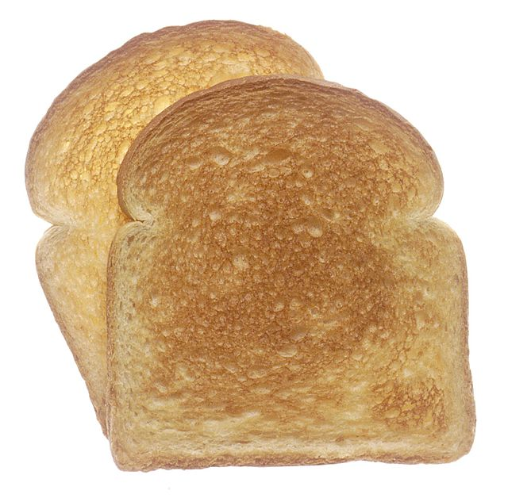
Chemical changes
Toast burning is also an example of a chemical change. You can scrape the burnt part off, but that doesn’t change the burnt part back into bread. A new substance was created.

Slide 12
Physical Properties of matter
We often describe matter with color, size, mass, and shape.
Another important physical characteristic we will be using is density.
Density is the amount of mass in a given volume.

Slide 13
Density
The units used for density are g/cmᶟ.
G = mass
cmᶟ= volume

Slide 14
Density of water
1 cmᶟ of water has a mass of 1 gram. This means the mass of water is 1÷1 = 1 g/cmᶟ.
This is important because anything with a density greater than 1 will sink. Anything with a density less than 1 will float. Something with a density of exactly 1 will float exactly even with the surface of water.

Slide 15
Density
To calculate density you need to measure the mass and volume of an object.
D = m÷v
A wooden block has a volume of 9 cmᶟ and a mass of 27 grams. What is its density? Will it sink or float?
27 ÷ 9 = 3 g/cmᶟ; it will sink

