Slide 1


Potential & Kinetic Energy

Slide 2
Essential Question:
How are potential & kinetic energy related?
Standard:
S8P2b. Explain the relationship between potential and kinetic energy.
Notes:
Instructional Approach(s): The teacher should introduce the essential question and the standard that aligns to the essential question

Slide 3
Concept
Attainment
Activity
[see resources]
Notes:
Instructional Approach(s): The teacher should conduct the Concept Attainment Activity [linked on the resource page] to activate student’s prior knowledge about potential and kinetic energy

Slide 4
Use the Kinetic & Potential Energy Graphic Organizer to take notes.
Notes:
Instructional Approach(s): The teacher should give each student a copy of the Energy Graphic Organizer [linked on the resource page] to record important information during the lesson.

Slide 5
What is energy?
Energy is the ability to cause change.
Everything around you has energy, but you notice it only when a change takes place.
Anytime a change occurs, energy is transferred from one object to another.
Notes:
Instructional Approach(s): The teacher should present the information on the slide while the students record the important information on their graphic organizer.

Slide 6



Explain how these objects cause change…
Notes:
Instructional Approach(s): The teacher should pose the question to the class. The teacher can either ask for volunteers or all on specific students to answer the question.

Slide 7
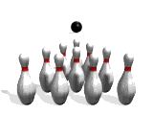
Things that move can cause change. For example, a bowling ball rolls down the alley and knocks down some pins. Is energy involved?
A change occurs when the pins fall over. The bowling ball causes this change, so the bowling ball has energy.
As the ball moves, it has a form of energy called kinetic energy.
Notes:
Instructional Approach(s): The teacher should present the information on the animated slide.

Slide 8
Kinetic Energy
Kinetic energy is the energy an object has due to its motion. If an object isn’t moving, it doesn’t have kinetic energy.
Notes:
Instructional Approach(s): The teacher should present the information on the slide while the students record the important information on their graphic organizer.

Slide 9

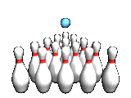
Kinetic Energy and Speed
Let’s use our bowling ball example. If you roll the bowling ball so it moves faster, what happens when it hits the pins?
A faster ball causes more change to occur than a ball that is moving slowly.
Kinetic energy increases as an
object moves faster.
Notes:
Instructional Approach(s): The teacher should present the information on the slide while the students record the important information on their notes.

Slide 10

Kinetic Energy
& Mass
Suppose you roll a volleyball down the alley instead of a bowling ball. If the volleyball travels at the same speed as a bowling ball, do you think it will send pins flying as far?
An important difference between the volleyball and the bowling ball is that the volleyball has less mass. Even though the volleyball is moving at the same speed, it has less kinetic energy because is has less mass.
Kinetic energy increases as the mass of an object increases.
Notes:
Instructional Approach(s): The teacher should present the information on the slide.

Slide 11
The Basics of Kinetic Energy
Kinetic Energy is the energy
of motion.
Kinetic energy increases as an
object moves faster.
Kinetic energy increases as the mass of an object increases.
Notes:
Instructional Approach(s): The teacher should present the information on the slide while the students record the important information on their notes.

Slide 12

What if the bowling ball is not moving? Does it still have energy?
Notes:
Instructional Approach(s): The teacher should pose the question to the class or call on students to answer the question.

Slide 13
Potential
Energy
Potential energy is the energy stored in an object because of its position. It has the “potential” to cause change.
Notes:
Instructional Approach(s): The teacher should present the information on the slide while the students record the important information on their notes.

Slide 14
Potential Energy
Imagine our bowling ball is sitting on a table. It has Potential Energy as it sits on the table because it has the ability to cause change.
What happens if the bowling ball falls off the table?
Potential Energy changes to Kinetic Energy
Notes:
Instructional Approach(s): The teacher should present the information on the animated slide.

Slide 15
Potential Energy
What happens to the Potential Energy of the bowling ball if the table is higher?
The Potential Energy of an object is greater if the position of the object is higher. The object has the potential to cause more change.
Notes:
Instructional Approach(s): The teacher should present the information on the animated slide while the students record the important information on their notes.

Slide 16
Potential Energy
How does mass affect the Potential
Energy of an object?
The more mass an object has, the more potential energy it has because it has the “potential” to cause more change.
Notes:
Instructional Approach(s): The teacher should present the information on the animated slide while the students record the important information on their notes.

Slide 17
The Basics of Potential Energy
Potential Energy is stored energy.
Potential Energy is greater if the position of an object is higher.
Potential energy increases as the mass of an object increases.
Notes:
Instructional Approach(s): The teacher should present the information on the slide while the students record the important information on their notes.

Slide 18
Changing Kinetic Energy & Potential Energy Activity
Use the QR Code activity to introduce the relationship between kinetic energy and potential energy if possible. Otherwise, use slides 21-27 with animations to demonstrate the concepts.
Notes:
Instructional Approach(s): Use the QR Code activity to introduce the relationship between kinetic energy and potential energy [linked on the resource page].

Slide 19
Changing Kinetic & Potential Energy
In a previous slide, we discussed how the potential energy of an object can change to kinetic energy.
For example, when you are holding the bowling ball, it has potential energy. As you release the ball, most of its energy is kinetic. However, as the ball begins to slow its kinetic energy decreases. But, the total energy of the ball hasn’t changed.
The decrease in kinetic energy equals the increase in potential energy. The total amount of energy remains constant.
Notes:
Instructional Approach(s): The teacher should present the information on the slide while the students record the important information on their notes.

Slide 20
Changing Kinetic
& Potential Energy
http://www.classzone.com/books/ml_science_share/vis_sim/mem05_pg69_potential/mem05_pg69_potential.html
Notes:
Instructional Approach(s): The teacher should use the link to demonstrate the relationship between kinetic and potential energy.

Slide 21
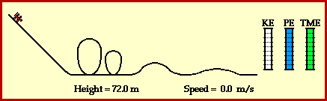
Changing Kinetic
& Potential Energy
http://www.physicsclassroom.com/mmedia/energy/ce.cfm
Notes:
Instructional Approach(s): The teacher should use the link to demonstrate the relationship between kinetic and potential energy. These animations [slides 21-27] are the same animations used in the QR Code activity linked on the resource page and described on slide 18.

Slide 22
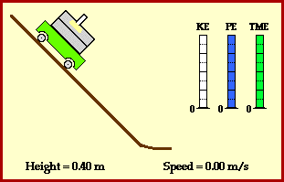
Changing Kinetic
& Potential Energy
http://www.physicsclassroom.com/mmedia/energy/ie.cfm
Notes:
Instructional Approach(s): The teacher should use the link to demonstrate the relationship between kinetic and potential energy.

Slide 23
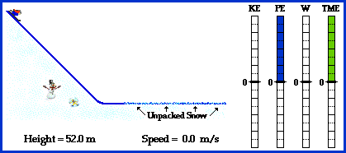
Changing Kinetic & Potential Energy
KE = Kinetic Energy
PE = Potential Energy
W = Work
TME = Time
http://www.physicsclassroom.com/mmedia/energy/se.cfm
Notes:
Instructional Approach(s): The teacher should use the link to demonstrate the relationship between kinetic and potential energy.

Slide 24
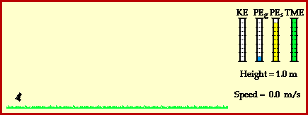
Changing Kinetic
& Potential Energy
Shooting a Dart
http://www.physicsclassroom.com/mmedia/energy/dg.cfm
Notes:
Instructional Approach(s): The teacher should use the link to demonstrate the relationship between kinetic and potential energy.

Slide 25
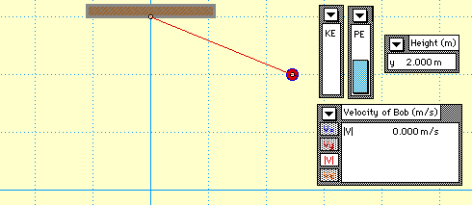
Changing Kinetic
& Potential Energy
Pendulum
http://www.physicsclassroom.com/mmedia/energy/pe.cfm
Notes:
Instructional Approach(s): The teacher should use the link to demonstrate the relationship between kinetic and potential energy.

Slide 26
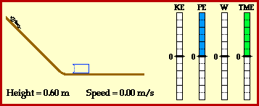
Changing Kinetic
& Potential Energy
http://www.physicsclassroom.com/mmedia/energy/hw.cfm
Notes:
Instructional Approach(s): The teacher should use the link to demonstrate the relationship between kinetic and potential energy.

Slide 27
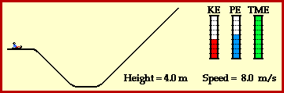
Changing Kinetic
& Potential Energy
http://www.physicsclassroom.com/mmedia/energy/hh.cfm
Notes:
Instructional Approach(s): The teacher should use the link to demonstrate the relationship between kinetic and potential energy.

Slide 28
Changing Kinetic
& Potential Energy
http://www.classzone.com/books/ml_science_share/vis_sim/mfm05_pg126_coaster/mfm05_pg126_coaster.html
Notes:
Instructional Approach(s): The teacher should use the link to demonstrate the relationship between kinetic and potential energy.

Slide 29
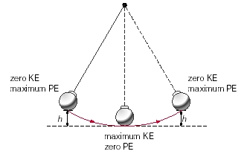
Notes:
Instructional Approach(s): The teacher should use the images on the slide to illustrate the relationship between kinetic and potential energy transformation in a pendulum.

Slide 30
Watch the video clip of the cartoon Road Runner. Identify at least two examples of Kinetic Energy and two examples of Potential Energy
http://www.youtube.com/watch?v=8H41zbqrwVo
Notes:
Instructional Approach(s): The teacher should use the link to demonstrate the relationship between kinetic and potential energy. Students could work individually or with a partner to identify the examples of kinetic and potential energy

Slide 31
Other Suggested Activities:
Trill Ride Activity, Spool Racer, or Button Whizzer
Kinetic & Potential Energy Images
Science of NHL Hockey
Notes:
Instructional Approach(s): If needed, the teacher can use the additional activities [linked on the energy resource page] to review or provide differentiation.

Slide 32
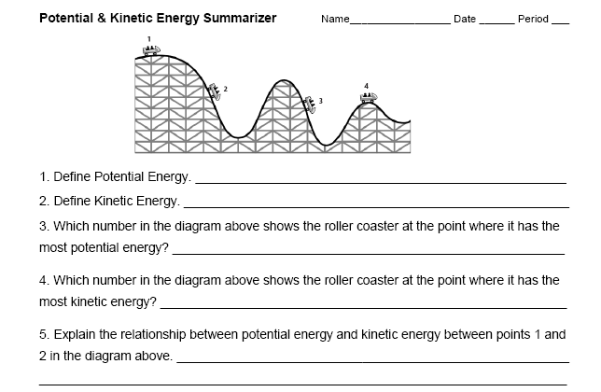
Summarizing Strategy
Notes:
Instructional Approach(s): Each student should complete the summarizer. The teacher should use the summarizer to determine the level of student mastery and if differentiation is needed.

