Slide 1
S8P1d. Distinguish between physical and chemical properties of matter as physical (i.e., density, melting point, boiling point) or chemical (i.e., reactivity, combustibility)
How are physical and chemical properties different?
Notes:
Instructional Approach(s): The teacher should present the essential question and the standard that aligns to the essential question.

Slide 2
Activating Strategy 1: An Accurate Description
Properties of a Cookie Activity
Notes:
Instructional Approach(s): Students or small groups of students (2-4) observe and list 10 characteristics of a cookie and then have to distinguish their cookie from other cookies based on those descriptions (leads to physical properties). For whatever reason if this activity is not appropriate, go to the next slide and use activating strategy number 2.

Slide 3
Activating Strategy 2: An Accurate Description
Display several cookies that have differences in color, odor, texture, size, shape, and state.
Describe each object in terms of its color, odor, texture, size, shape, and state.
Why it is important to use a variety of properties when describing objects?
Notes:
Instructional Approach(s): The teacher should follow the directions on the slide. The teacher should then briefly discuss their responses to the question on the slide.

Slide 4
Use the Physical and Chemical Properties of Matter Notes to record important information in the lesson
Notes:
Instructional Approach(s): The teacher should give each student a copy of the Physical and Chemical Properties of Matter Notes [linked on the matter resource page] to record important information during the lesson.

Slide 5
Properties of Matter
The properties of a substance are those characteristics that are used to identify or describe it
It doesn’t matter how much or how little of the substance you have, these properties are always the same.
Properties can be classified as Physical or Chemical
Notes:
Instructional Approach(s): The teacher should present the slide while the students record the important information on their notes.

Slide 6
Physical Properties of Matter
Properties that are observable, measurable, and will keep the same composition (nothing new is created)
Some Physical Properties include:
Color | Luster | Solubility
Size | Hardness | Conductivity
Odor | Condensing | Boiling point
Density | Melting point
Notes:
Instructional Approach(s): The teacher should present the slide while the students record the important information on their notes.

Slide 7
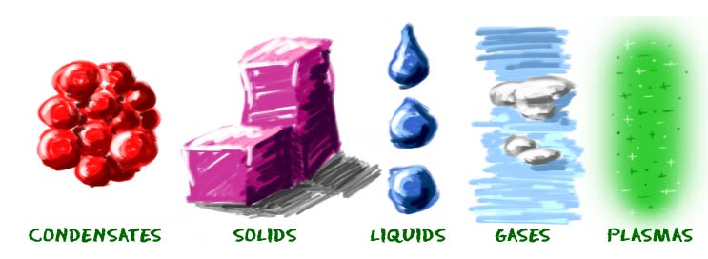
Physical Properties of Matter
Some physical properties are easier to understand than others such as Color, Size, Odor, Luster (Shine), and Hardness
Changes in state of matter such as melting, boiling, freezing, and condensing do not create a new substance and retain their original composition and is therefore a physical property
Notes:
Instructional Approach(s): The teacher should present the slide while the students record the important information on their notes.

Slide 8
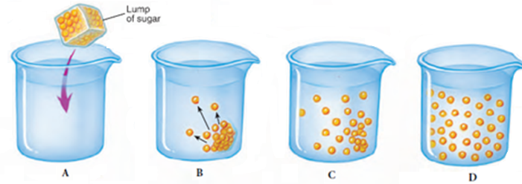
Physical Properties of Matter: Solubility
Solubility is the ability of a substance to dissolve in another substance. Flavored drink mix dissolves in water. Or, as the image shows, a lump of sugar dissolving in water.
Notes:
Instructional Approach(s): The teacher should present the slide while the students record the important information on their notes.

Slide 9
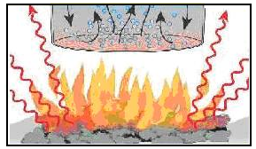
Physical Properties of Matter: Conductivity
Conductivity is the ability to conduct or transmit heat, electricity, or sound.
Notes:
Instructional Approach(s): The teacher should present the slide while the students record the important information on their notes.

Slide 10
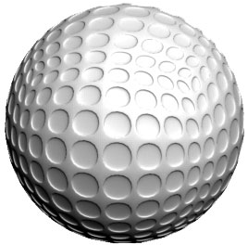
Physical Properties of Matter: Density
Density is the amount of matter (mass) in a given space (volume)
Density equals Mass divided by Volume (D=M/V)
For example, a golf ball and a table-tennis ball have similar volumes. But a golf ball has more mass than a table-tennis ball does. So, the golf ball has a greater density.
Notes:
Instructional Approach(s): The teacher should present the slide while the students record the important information on their notes.

Slide 11
Physical Properties of Matter: Density of Solids
Which would you rather carry around all day: a kilogram of lead or a kilogram of feathers?
At first, you might say feathers. But both the feathers and the lead have the same mass. However, the lead would be less awkward to carry around than the feathers would. Why?
The feathers are much less dense than the lead. So, it takes a lot of feathers to equal the same mass of lead.
Notes:
Instructional Approach(s): The teacher should pose the first question to the class and listen to a few student responses. Then, click the mouse to pose the second question to the class and listen to a few student responses. When ready, click the mouse again to show the answer

Slide 12
Physical Properties of Matter: Density of Solids
Which square is more dense? Why?
Which square is more dense? Why?
There are more particles (matter) for the same space (volume)
The smaller square has the same number of particles, but in a smaller space (volume)
Notes:
Instructional Approach(s): The teacher should go over the information on the slide. The students can either first try to answer the questions on their own on their notes or fill in their notes with the correct answers when instructed by the teacher

Slide 13
Physical Properties of Matter: Density of Solids
Knowing the density of a substance can also tell you if the substance will float or sink in water.
If the density of an object is less than the density of water, the object will float. Likewise, a solid object whose density is greater than the density of water will sink when the object is placed in water.
Explore the Density of Solids and Water using the PhET simulation on density and buoyancy
Notes:
Instructional Approach(s): The teacher should present the slide while the students record the important information on their notes.

Slide 14
Physical Properties of Matter: Density of Liquids
Like all substances, liquids have different densities
It is easy to see the differences in the density of liquids because more dense liquids will sink and less dense liquids will rise
If you pour together liquids that don’t mix and have different densities, they will form liquid layers.
Making Liquid Layers: http://www.youtube.com/watch?v=-CDkJuo_LYs
Notes:
Instructional Approach(s): The teacher should present the slide while the students record the important information on their notes.

Slide 15
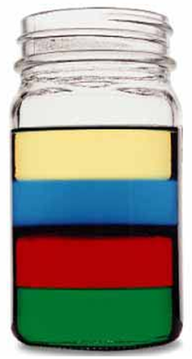
Physical Properties of Matter: Density of Liquids
Check out this picture. Which layer has the highest density?
Which layer has the lowest density?
Imagine that the liquids have the following densities:
10g/cm³ 3g/cm³
6g/cm³ 5g/cm³
Which number would go with which layer?
3g/cm³
5g/cm³
6g/cm³
10g/cm³
Notes:
Instructional Approach(s): The teacher should present the slide and call on students or ask for volunteers to answer the various questions. When ready, the teacher can click the mouse to show each answer

Slide 16
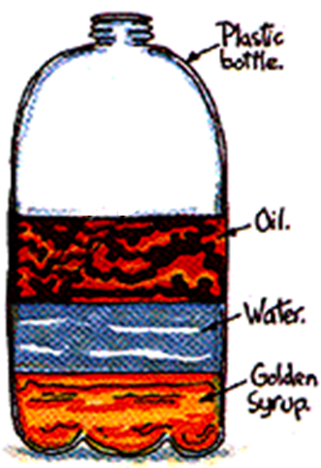
Physical Properties of Matter: Density of Liquids
Try with your neighbor!
Which liquid has the highest density?
Which liquid has the lowest density?
Which liquid has the middle density?
Notes:
Instructional Approach(s): The students should turn to a neighbor to answer the questions. Partners can be determined by the students or the teacher can provide more specific directions such as turn to the person directly in front/behind you or to the right/left of you, etc. It may be necessary to have a group of three if you have an uneven number of students. Do not allow more than 30 seconds to 1 minute of discussion time. The teacher should be walking around listening and redirecting discussions as needed. When ready, click the mouse to show the answers. Students should then answer the appropriate question on their notes in reference to the diagram

Slide 17
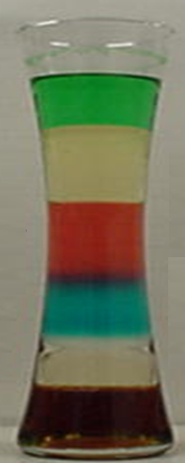
Physical Properties of Matter: Density of Liquids
Try on your own!
Imagine that the liquids on the right have the following densities:
15g/cm³ 10g/cm³
3g/cm³ 9g/cm³
7g/cm³ 12g/cm³
Match the colors to the correct densities.
Notes:
Instructional Approach(s): Students should individually answer the question on the slide. The teacher should walk around to monitor and provide assistance when needed. Click to the next slide when ready to go over the answers.

Slide 18
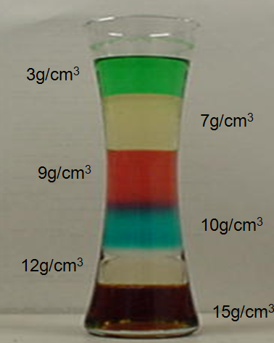
Physical Properties of Matter: Density of Liquids
Try on your own!
Imagine that the liquids on the right have the following densities:
15g/cm³ 10g/cm³
3g/cm³ 9g/cm³
7g/cm³ 12g/cm³
Match the colors to the correct densities.
Notes:
Instructional Approach(s): The teacher should present the correct answers on this slide for the previous slide.

Slide 19
Physical Properties of Matter Lab(s) [see resources for suggestions or use your own]
Notes:
Instructional Approach(s): This is a good place in the lesson to stop and do a lab or stations of labs on the physical properties of matter. See the matter resource page for suggestions

Slide 20
How would you describe a piece of wood before and after it is burned? Has it changed color? Does it have the same texture? The original piece of wood changed, and physical properties alone cannot describe what happened to it.
Notes:
Instructional Approach(s): The teacher should pose the question to the class and briefly discuss student responses. When ready, click the mouse for the next statement leading to the chemical properties of matter

Slide 21
Chemical Properties of Matter
Chemical properties are only observable during a chemical reaction and allows for change (something new is created)
The property is the ability to change whereas the change is the action itself
Some chemical properties include: Reactivity, Combustibility, Flammability
Notes:
Instructional Approach(s): The teacher should present the slide while the students record the important information on their notes.

Slide 22
Chemical Property of Matter: Reactivity
Reactivity describes how easily something reacts with something else
Reactivity can also be described as the ability of a substance to combine with another substance and form a new substance
Short clips showing the various reactions of elements with water
Notes:
Instructional Approach(s): The teacher should present the slide while the students record the important information on their notes.

Slide 23
Chemical Property of Matter: Combustibility
Combustibility is a substance or material that is able or likely to catch fire and burn
Flammability is often described as a chemical property as well. Flammability occurs at a lower temp than combustibility
Video clip showing various combustion reactions
Whoosh Bottle Combustion Reaction video clip
Notes:
Instructional Approach(s): The teacher should present the slide while the students record the important information on their notes.

Slide 24
Physical and Chemical Properties Sorting Activity
Distributed Summarizing:
https://padlet.com/austina12/Properties_Sort
Notes:
Instructional Approach(s): Students are placed into groups of 2-3. Each group sorts a set of cards as either an example of a physical property or a chemical property. The Physical and Chemical Properties Sorting Activity is linked on the matter resource page

