Slide 1
Essential Question: How do particles behave in the four states of matter?
S8P1c. Describe the movement of particles in solids, liquids, gases, and plasmas state.
Notes:
Instructional Approach(s): The teacher should introduce the essential question and the standard that aligns to the essential question

Slide 2
Activating Strategy
Watch the first 3 – 3 ½ minutes of the video below. How they would answer the commentator’s questions?
http://www.youtube.com/watch?v=KCL8zqjXbME
Notes:
Instructional Approach(s): The teacher should show the first 3-3 ½ minutes of the video clip and ask the class or have students pair up then discuss as a class how they would respond to the commentator.

Slide 3
Use the Particle Movement in the States of Matter Notes to record important information during the lesson.
Notes:
Instructional Approach(s): The teacher should give each student a copy of the Particle Movement in the States of Matter notes [linked on the matter resource page] to record important information during the lesson.

Slide 4
Matter
Atoms and molecules in matter are always in motion and are always bumping into one another.
The speed and attraction of particles determines the state of matter.
There are 3 familiar states of matter: solid, liquid, and gas
A fourth state of matter called plasma only occurs at very high temperatures
Notes:
Instructional Approach(s): The teacher should present the information on the slide while the students record the important information on their notes

Slide 5
Imagine dropping a marble into a bottle.
Would anything happen to the shape or size of the marble?
Would the shape or size of the marble change if you put it in a larger bottle?
Even in a bottle, a marble keeps its original shape and volume because it is a solid.
Notes:
Instructional Approach(s): The teacher should pose the questions to the class and have a very brief discussion as to why the marble would not change its shape or size. When ready, click the mouse to show the last bullet on the slide with an answer

Slide 6
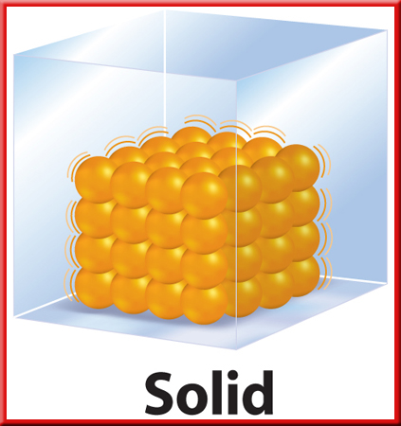
A solid is the state of matter that has a definite shape and volume.
The particles of a substance in a solid state are very close together and there is a strong attraction between them
Notes:
Instructional Approach(s): The teacher should present the information on the slide while the students record the important information on their notes

Slide 7
Solid
The particles in a solid move, but they do not move fast enough to overcome the attraction between them.
Each particle vibrates in place. As shown in the diagram to the right
Particles in a solid have LESS ENERGY than particles in other states
http://www.middleschoolchemistry.com/multimedia/chapter1/lesson4#particles_of_a_solid
Notes:
Instructional Approach(s): The teacher should present the information on the slide while students record the important information on their notes. When ready, the teacher should click on the link to show an animation of the movement of particles in a solid

Slide 8
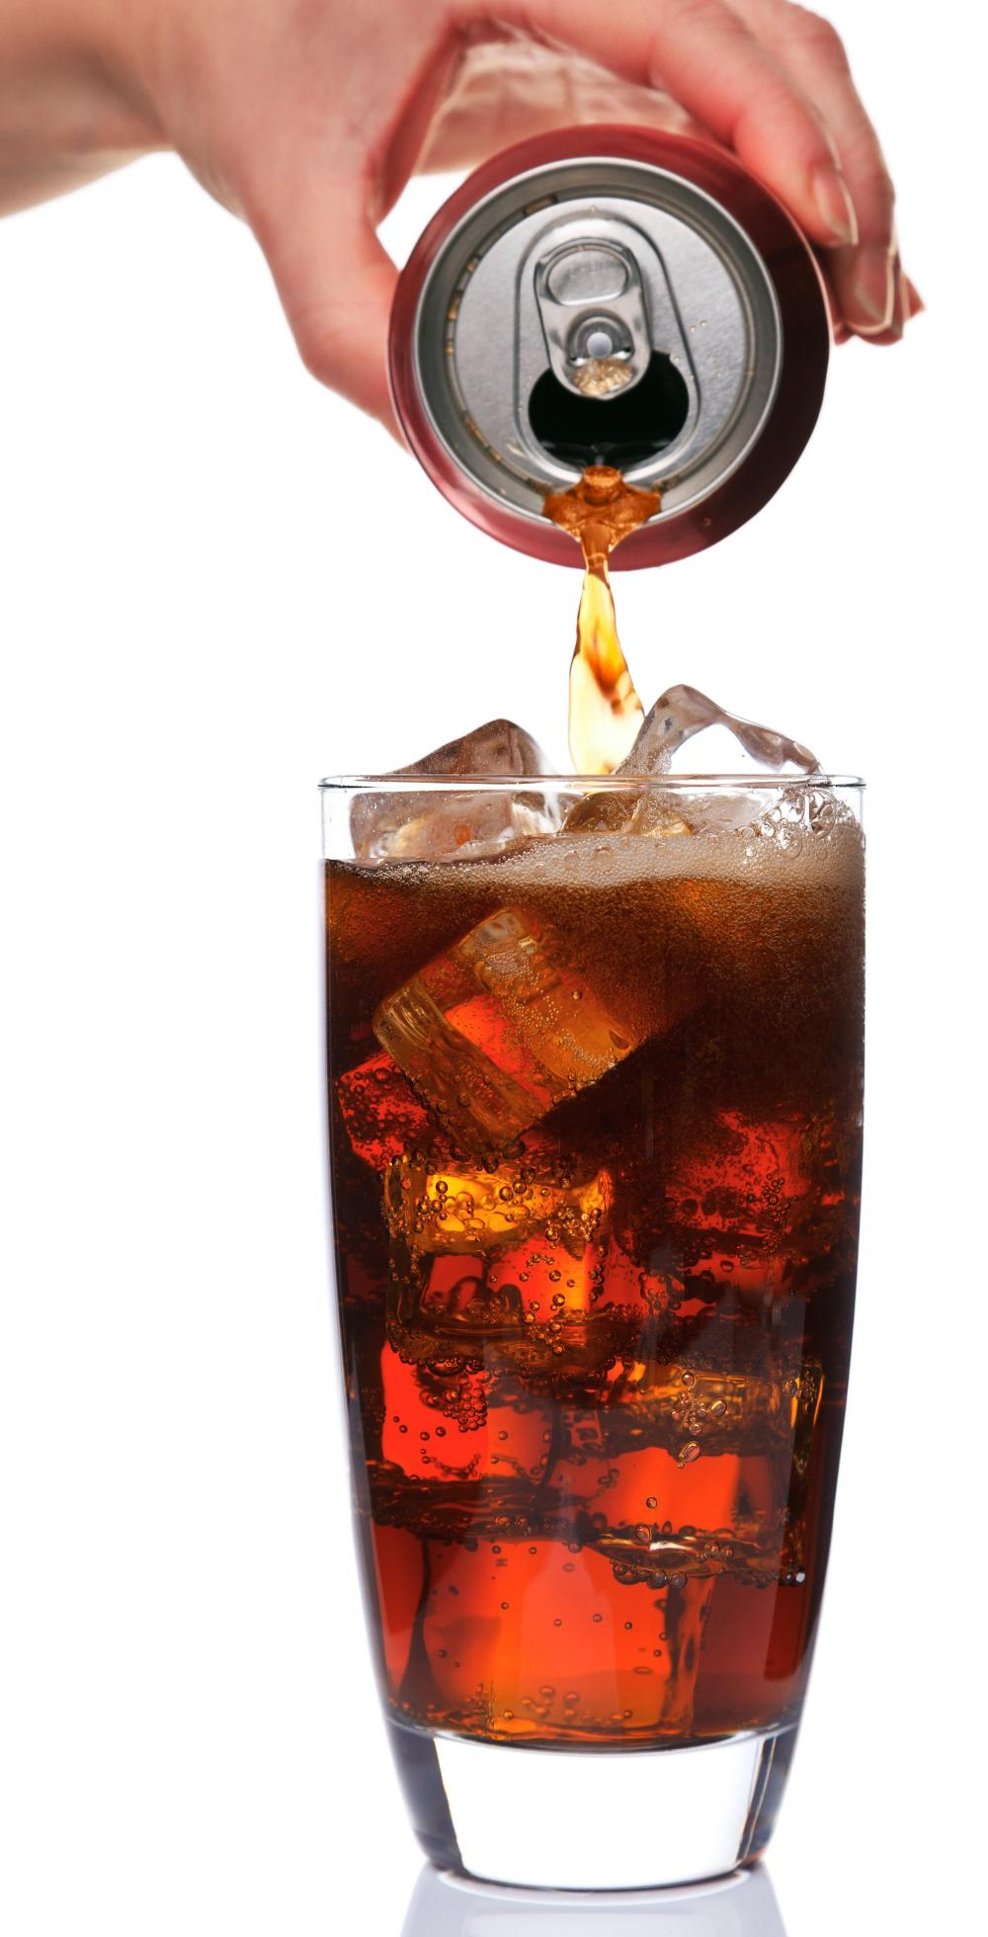
What do you think would change about soda if you poured it from a can into a glass?
Would the volume of the soda be different?
Would the taste of the soda change?
Notes:
Instructional Approach(s): The teacher should pose the questions to the class and spend 1 minute or less discussing their responses

Slide 9
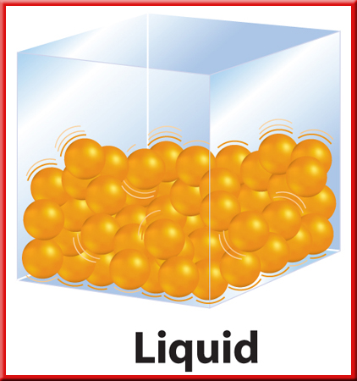
Liquid is the state of matter that has a definite volume but no definite shape
A liquid takes the shape of its container
Although liquids change shape, the volume stays the same
Notes:
Instructional Approach(s): The teacher should present the information on the slide while students record the important information on their notes

Slide 10
Liquid
The particles in liquids move fast enough to overcome some of the attractions between them.
The particles slide past each other until the liquid takes the shape of its container
Particles in liquids have more energy than particles in solids
Comparing solid and liquid movement of particles: http://www.middleschoolchemistry.com/multimedia/chapter1/lesson4#particles_of_a_solid
Notes:
Instructional Approach(s): The teacher should present the information on the slide while students record the important information on their notes. When ready, the teacher should click on the link to show an animation of the movement of particles in a liquid

Slide 11
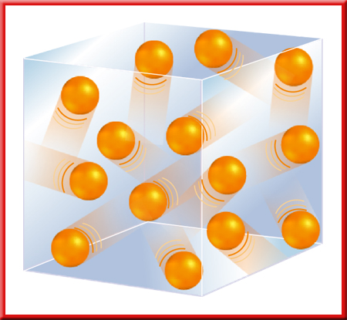
Gas
A gas is the state of matter that has NO definite shape or volume.
The particles of a gas move quickly. So, they can break away completely from one another
The amount of empty space between gas particles can change
Notes:
Instructional Approach(s): The teacher should present the information on the slide while students record the important information on their notes.

Slide 12
Gas
The particles of a gas have less attraction between them than do particles of the same substance in the solid or liquid state.
The particles of a Gas have more energy than the particles of a liquid or a solid
Notes:
Instructional Approach(s): The teacher should present the information on the slide while students record the important information on their notes.

Slide 13
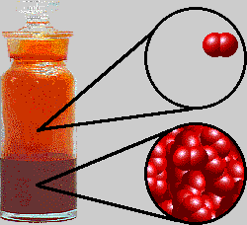
Comparing the Liquid and Gas State of the Element Bromine
Which is the Liquid State? Which is the Gaseous State?
Notes:
Instructional Approach(s): The teacher should use the image on the slide to call on students or discuss as a class which illustrates a liquid state and a gaseous state. Be sure to ask students why or how they know

Slide 14
Study Jams Video: Solids, Liquids, Gases
Notes:
Instructional Approach(s): The teacher should show the short video clip to reinforce solids, liquids, and gases

Slide 15
Additional Activities [see resources]:
States of Matter Game
Let It Change! Activity
Scattered Matter Demonstration
Moving on Up – Modeling Phase Change Task
Pop Top
Demonstration of warm air expanding and rising
Notes:
Instructional Approach(s): The teacher should select one, possibly two of the activities to reinforce particle movement in the various states of matter if needed

Slide 16
Plasma
Plasmas have the highest energy of the states of matter.
The energy not only exceeds the attractive forces among molecules but also exceeds the attractive forces that hold atoms together.
As a result, molecules of plasma are broken down into a cloud of protons, neutrons, and electrons that all move and function together.
Examples of Plasma: Lightning, fire, neon lights, Northern lights, stars
Notes:
Instructional Approach(s): The teacher should present the information on the slide while the students record the important information on their notes

Slide 17
States of Matter Song [uses some concepts and vocabulary beyond our standard] http://www.youtube.com/watch?v=vDZhUkp30tE
Notes:
Instructional Approach(s): The teacher should use the States of Matter Song to reinforce the states of matter. Be sure to let students know that they are not responsible for everything in the song because some of the concepts and vocabulary are beyond the standard

Slide 18
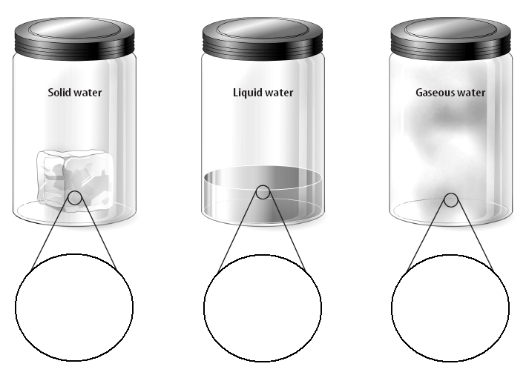
Distributed Summarizing
Illustrate the movement of particles in a solid, liquid, and gas in the diagram on your Notes Sheet.
Notes:
Instructional Approach(s): The teacher should ask students to complete the diagram as shown on the slide on their notes sheet. The teacher should walk around and monitor student performance. After 1-2 minutes, the teacher can move to the next slide showing the answer or have students compare with a partner and discuss any differences

Slide 19
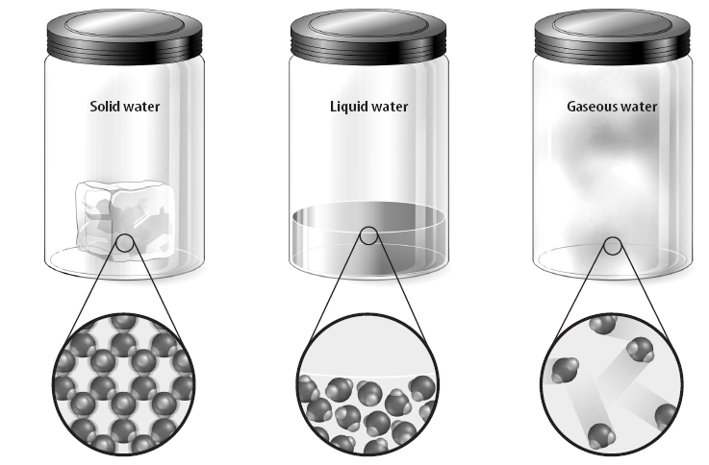
Notes:
Instructional Approach(s): The teacher should use the slide to demonstrate an example of how the student diagrams should look. Be sure students understand that their drawing does not have to be identical to the one on the slide. The solid water should be close together while the liquid water particles should be farther apart. The gas particles should be further apart than the liquid water particles and should indicate movement

Slide 20
It can be tricky to eat a frozen juice bar outside on a hot day.
In just minutes, the juice bar will start to melt. Soon the solid juice bar becomes a liquid mess.
As the juice bar melts, it goes through a change of state.
Notes:
Instructional Approach(s): The teacher should present the information on the slide and use it as a transition slide into the next big topic: Changes in State

Slide 21
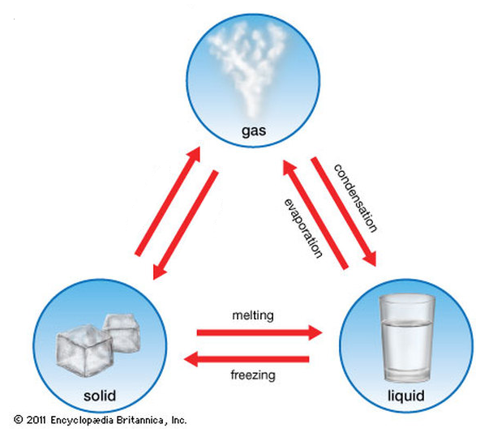
Changes in State [Phase Change]
We will look at only four changes of state
Notes:
Instructional Approach(s): The teacher should present the information on the slide as an introduction into Phase Change

Slide 22
Energy and Changes in State
As described earlier, particles in liquids have more energy than particles in solids, and particles in gases have more energy than particles in liquids
Therefore, to change a substance from one state to another, you must add or remove energy
Notes:
Instructional Approach(s): The teacher should present the information on the slide while the students record the important information on their notes

Slide 23
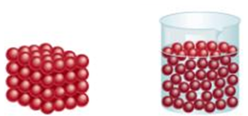
Melting: Solid to Liquid
Adding energy to a solid increases the temperature of the solid. As the temperature increases, the particles of the solid move faster.
When a certain temperature is reached, the solid will melt.
The temperature at which a substance changes from a solid to a liquid is the melting point of the substance. Which type of property is melting point?
Physical Property of Matter
Notes:
Instructional Approach(s): The teacher should present the information on the slide while the students record the important information on their notes. The teacher should pose the question in the last bullet to the class. After a minute or less, click the mouse to show the answer

Slide 24
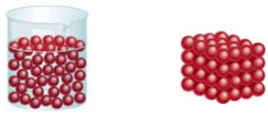
Freezing: Liquid to Solid
Removing energy from a liquid (decreasing temperature) will cause the particles to slow down and begin locking into place
When a certain temperature is reached, the liquid will freeze. Freezing is the reverse of melting; thus, freezing and melting occur at the same temperature (one adds energy and one removes energy)
Notes:
Instructional Approach(s): The teacher should present the information on the slide while the students record the important information on their notes.

Slide 25
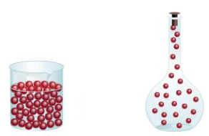
Boiling/Evaporating: Liquid to Gas
As energy is added to a liquid (increasing temperature), particles throughout the liquid move faster
When particles move fast enough to break away from other particles, they evaporate and become a gas
Notes:
Instructional Approach(s): The teacher should present the information on the slide while the students record the important information on their notes.

Slide 26
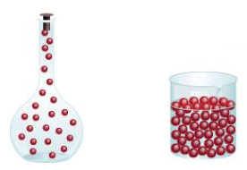
Condensing: Gas to Liquid
Condensation is the change of state from a gas to a liquid
Removing energy (decreasing temperature) from a gas will cause the particles to slow down
When the attraction between the particles overcomes their motion, the particles clump together to form condensation
Notes:
Instructional Approach(s): The teacher should present the information on the slide while the students record the important information on their notes.

Slide 27
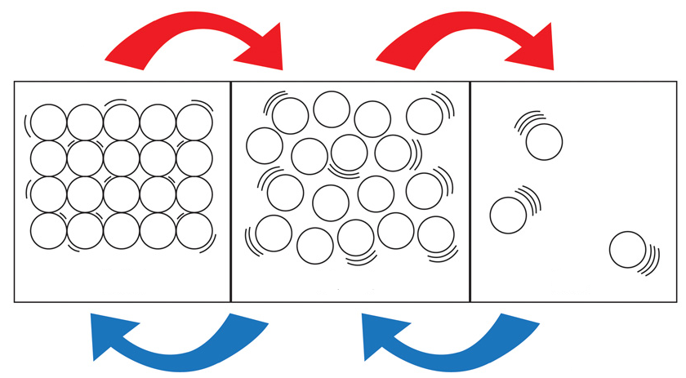
On your notes identify which box represents a solid, liquid, and gas. Then, identify what both arrows represent
Notes:
Instructional Approach(s): The teacher should ask students to complete the diagram as shown on the slide on their notes sheet. The teacher should walk around and monitor student performance. After 1-2 minutes, the teacher can move to the next slide showing the answer or have students compare with a partner and discuss any differences

Slide 28
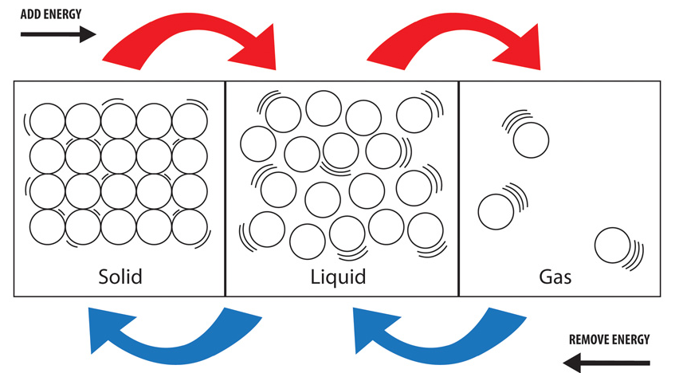
Energy and Changes in State
Notes:
Instructional Approach(s): The teacher should show the slide and walk around to make sure that all students have recorded the information correctly on their notes

Slide 29
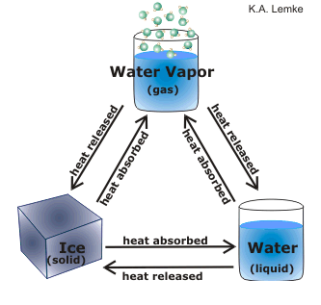
Adding Energy can also be viewed as adding or removing heat (form of energy)
Notes:
Instructional Approach(s): The teacher should present the information on the slide while the students record the important information from the diagram on their notes

Slide 30
Relationship between Energy, Temperature, and Particle Movement
When most substances lose or gain energy, one of two things happens to the substance: its temperature changes or its state changes.
The temperature of a substance is related to the speed of the substance’s particles.
So, when the temperature of a substance changes, the speed of the particles also changes.
Notes:
Instructional Approach(s): The teacher should preset the information on the slide to reinforce the relationship between energy, temperature, and particle movement

Slide 31
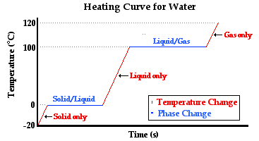
Relationship between Energy, Temperature, and Particle Movement
Notes:
Instructional Approach(s): The teacher should preset the information on the slide to reinforce the relationship between energy, temperature, and particle movement

Slide 32
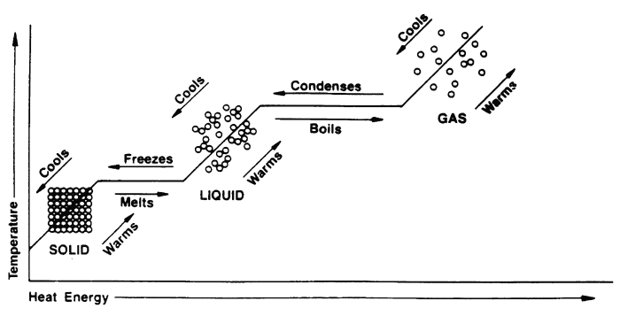
Relationship between Energy, Temperature, and Particle Movement
Notes:
Instructional Approach(s): The teacher should preset the information on the slide to reinforce the relationship between energy, temperature, and particle movement

Slide 33
Simulation of the movement of particles in solids, liquids, and gases when heat is added: http://www.bgfl.org/bgfl/custom/resources_ftp/client_ftp/ks3/science/changing_matter/changingmatter.swf
Notes:
Instructional Approach(s): The teacher should show the simulation to reinforce the movement of particles in solids, liquids, and gases when heated

Slide 34
Let’s see the Effects of Temperature and Particle Movement
As particles in matter move faster, they push out with greater force and can cause matter to expand
http://www.middleschoolchemistry.com/multimedia/chapter1/lesson4#heating_cooling_metal_ball
Notes:
Instructional Approach(s): The teacher should show the simulation to reinforce the movement of particles in solids, liquids, and gases when heated

Slide 35
Modeling Particle Movement in Phase Change Activity
Distributed Summarizing:
Notes:
Instructional Approach(s): Students or small groups of students use small food items (fruit loops, skittles, M&Ms, etc.) or other small objects to represent particles in matter. Students then model particle movement in various phase changes of matter as well as show when heat and energy are added. See the activity linked on the matter resource page for additional instructions

Slide 36
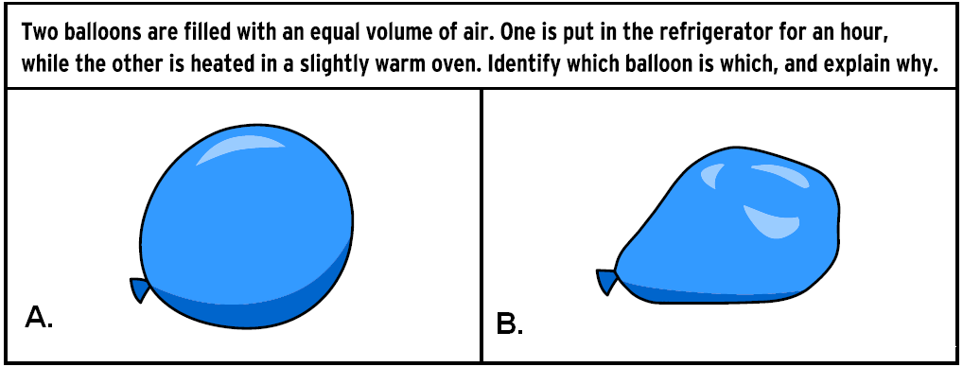
Summarizing Strategy:
Balloon Flux Constructed Response
Notes:
Instructional Approach(s): Each student should complete the summarizer. The teacher should use the summarizer to determine the level of student mastery and if differentiation is needed.

