Slide 1
Wave Properties
How do frequency, amplitude, and wavelength of a transverse wave affect its energy?
Notes:
Show this slide when introducing the task, the guiding questions, and the hints for the lab (stage 1)

Slide 2
Background Information
Stage 1: Identification of the task & guiding question

Slide 3
What is a wave?
A disturbance that transmits energy through matter or space
“a wiggle in time”
The wave medium is not the wave nor does it make the wave. The medium transports the wave from its source to other locations.

Slide 4
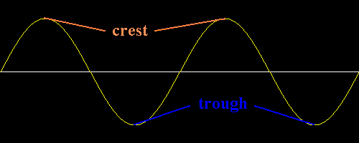
Basic Parts of a Wave
Crest - the section of the wave that rises above the rest position.
Trough - the section which lies below the rest position.
Resting position
http://id.mind.net/~zona/mstm/physics/waves/partsOfAWave/waveParts.htm
Notes:
If we consider the rope mentioned before, this wave could be created by vertically shaking the end of the rope.

Slide 5
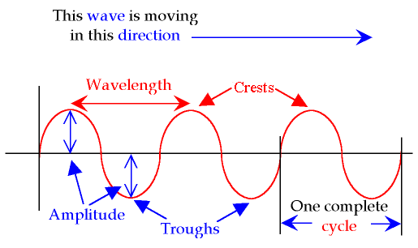
Parts of a Wave
TERMS: wavelength, frequency, velocity, amplitude, crest, trough, cycle.
http://science-class.net/Notes/Images_8th_Notes/Transverse-Wave.png

Slide 6
What do waves carry?
ENERGY
Energy is carried away from a source, but the material the wave travels through (medium) does not move with the energy.
Stadium waves are a good model of a wave. In this model, people are the particles in the medium. They vibrate “up and down”. The “energy” is transported, but the particles return to their starting position.

Slide 7
Classifying Waves
Mechanical Waves
Electromagnetic
Waves
Require a MEDIUM through which to travel – solid, liquid, gas
Sound waves, water waves, earthquake waves, ocean waves
May be transverse or longitudinal waves
DO NOT require a MEDIUM through which to travel – can travel in a vacuum or through a medium
Radiowaves, X-ray, Infrared (heat), Gamma, Light (sun)
Are all transverse waves

Slide 8
Longitudinal Waves
Particles vibrate back and forth along path wave travels
Compression = particles are crowded
Rarefaction = particles less crowded
Sound waves are longitudinal
science-class.net/Notes/Notes_waves.htm

Slide 9
Longitudinal Wave
Particle displacement is parallel to the direction of wave propagation.
The particles do not move with the wave; they oscillate back and forth about their positions.
http://www.kettering.edu/~drussell/Demos/waves/wavemotion.html

Slide 10
Transverse Wave
Particle displacement is perpendicular to the direction of wave propagation.
The particles do not move along with the wave; they oscillate up and down their positions as the wave passes by.
All Electromagnetic waves are transverse waves.
http://www.kettering.edu/~drussell/Demos/waves/wavemotion.html
Notes:
Pick a single particle and watch its motion.

Slide 11
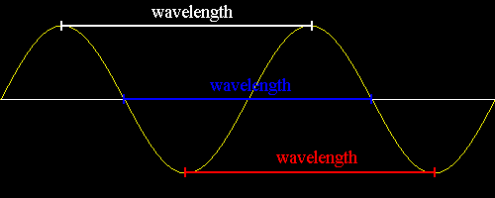
Wavelength (l)
Distance between 2 crest/troughs or 2 compressions/rarefactions
Measured in meters (m)
http://id.mind.net/~zona/mstm/physics/waves/partsOfAWave/waveParts.htm

Slide 12
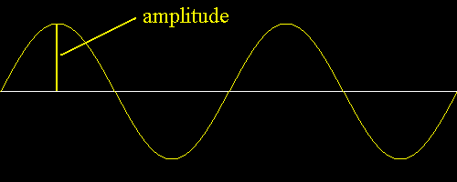
Amplitude
Maximum distance the wave vibrates from rest position
Related to height
Measured in meters (m)
Large amplitude = tall wave Small amplitude = short wave
http://id.mind.net/~zona/mstm/physics/waves/partsOfAWave/waveParts.htm

Slide 13
Explore: Waves on a String
https://phet.colorado.edu/en/simulation/wave-on-a-string

Slide 14
Explore: Waves on a String

Slide 15
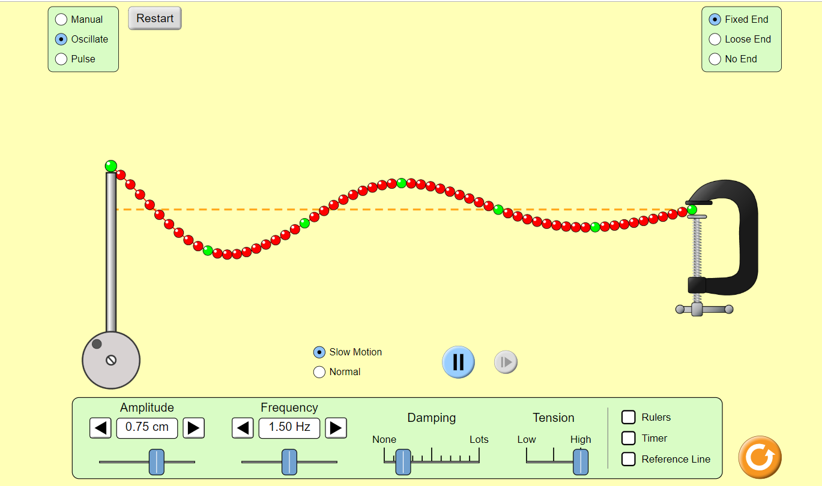

Slide 16
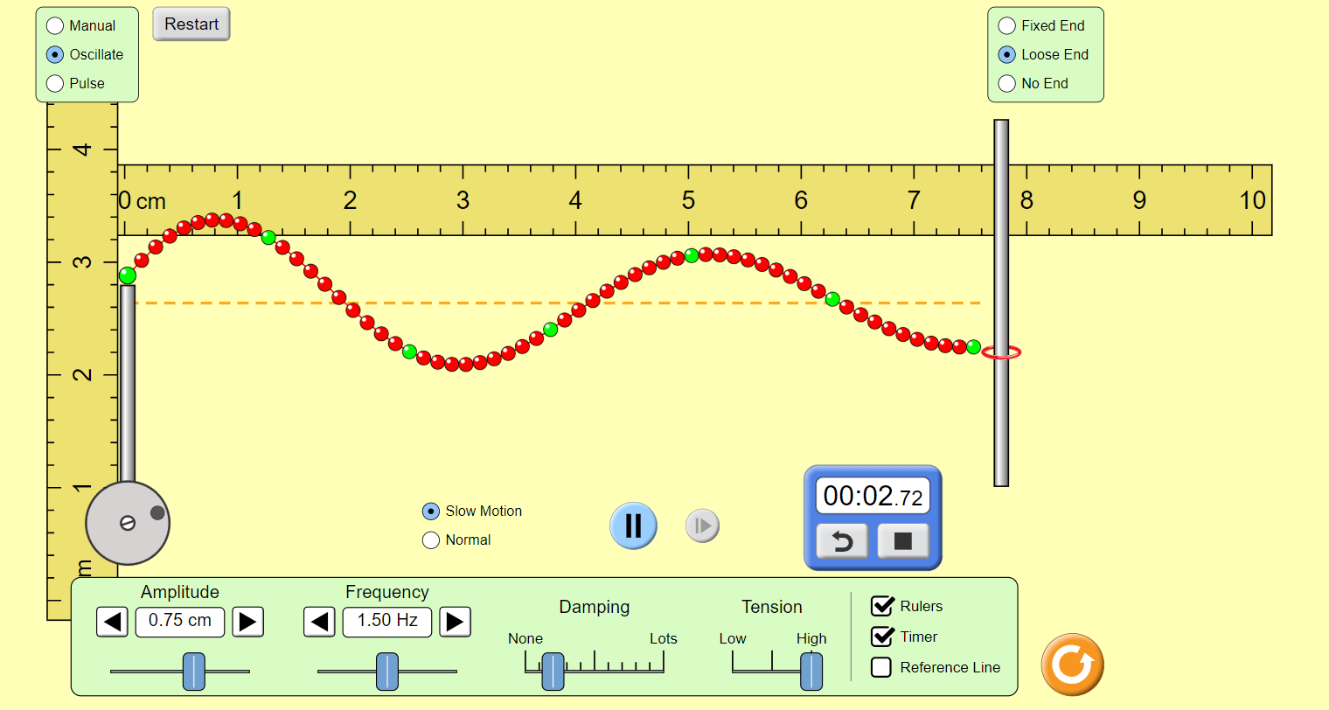

Slide 17
How will your organize your data?
Stage 2: Design a method & collect data
To determine what type of data you need to collect, think about the following questions:
How will you test the ability to make the action figure jump higher?
How will you measure the height of the jump?
What type of measurements or observations will you need to record during your investigation?
To determine how you will collect your data, think about the following questions:
How often will you collect data and when will you do it?
How will you make sure that your data are of high quality (i.e., how will you reduce error)?
How will you keep track of the data you collect and how will you organize it?
To determine how you will analyze your data, think about the following questions:
What type of calculations will you need to make?
What type of graph could you create to help make sense of your data?

Slide 18
Collect data during your investigation

Slide 19
Your answer to the question
Planning your initial argument
This graph shows…
Our evidence is based on the following assumptions…
Data + Analysis + Interpretation of the Analysis
Use scientific concepts to explain why the evidence is important (you can also describe your assumptions)
Interpretation = What does the analysis mean?
Justification = Why does the evidence matter?
Stage 3: Analyze data and create a tentative argument
Notes:
Show this slide when students are creating their initial arguments (stage 3)

Slide 20
What is the difference between evidence and justification?

Slide 21
Argumentation Session: Stay & Stray
“Stay”: Leave 1-2 lab members behind with your board. Their role is to explain their data and what it means as other groups come by.
“Stray”: Send 1-2 lab members to visit other boards. You will rotate in a clockwise fashion and change groups at the signal.
Questions to Ask/Discuss:
How did you collect your data? Why did you use that method? Why did you collect those data?
What did you do to make sure the data you collected are reliable? What did you do to decrease measurement error?
How did your group analyze the data? Why did you decide to do it that way? Did you check your calculations?
Is that the only way to interpret the results of your analysis? How do you know that your interpretation of your analysis is appropriate?
Why did your group decide to present your evidence in that way?
What other claims did your group discuss before you decided on that one? Why did your group abandon those alternative ideas?
How confident are you that your claim is valid? What could you do to increase your confidence?
Stage 4: Argumentation Session

Slide 22
Stage 5: Explicit/Reflective Discussion
Let’s talk a little about the big ideas underlying this investigation
Notes:
Use this slide to discuss the core ideas during the explicit reflective discussion (stage 5)

Slide 23
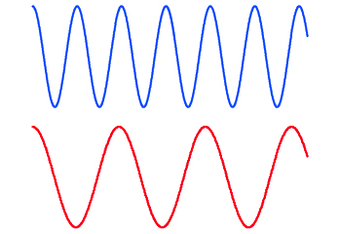
What is going on in this image?

Slide 24
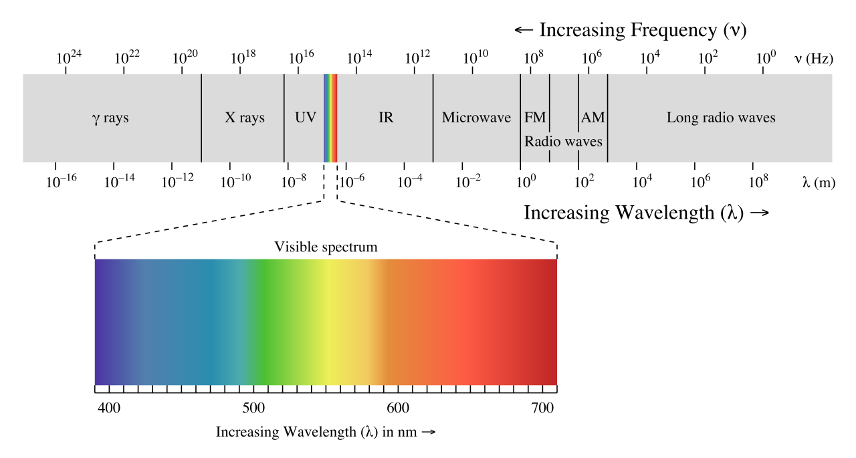
What is going on in this image?

Slide 25
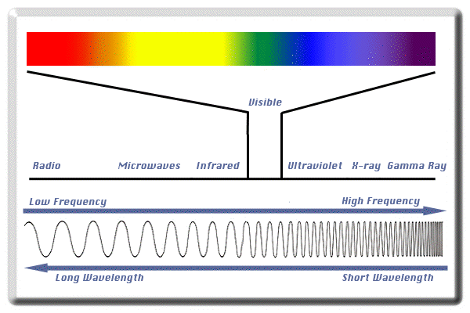
How does the frequency and wavelength vary?
http://www.lcse.umn.edu/specs/labs/images/spectrum.gif

Slide 26
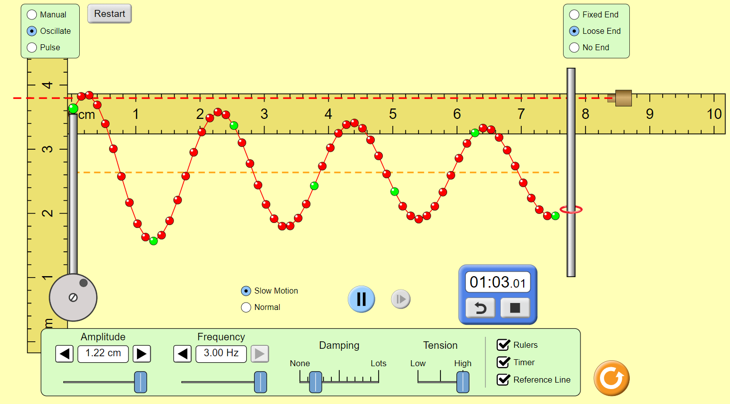
What happens when the frequency increases?

Slide 27
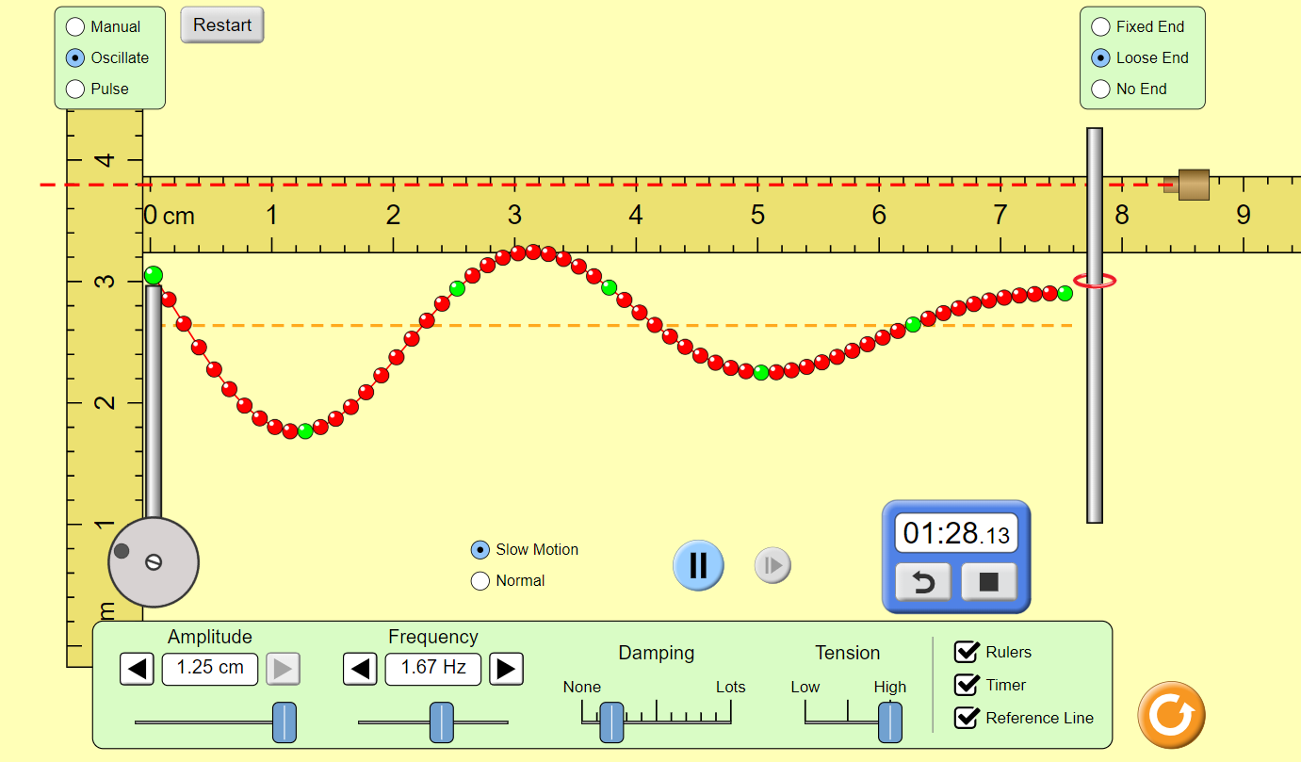
What happens when the amplitude increases?

Slide 28
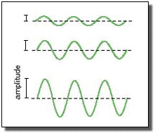
Amplitude
Small amplitude = short wave = low energy
Large amplitude = tall wave = high energy

Slide 29
What kind of wave is this?
Transverse wave

Slide 30
Some core ideas you can you to help justify your evidence…
A simple wave model has a repeating pattern with a specific wavelength, frequency, and amplitude. Waves can transmit energy.
The higher the amplitude, the more energy a wave has. The shorter the wavelength, the more energy it has.
Electromagnetic waves do not require a medium. The properties and uses of EM waves vary based on their properties. All EM waves are transverse waves.
Mechanical waves such as water, sound, and seismic, need a medium through which they are transmitted. Some are transverse and others are longitudinal. Geologists use seismic waves and their reflection at interfaces between layers to probe structures deep in the planet.
Notes:
Use this slide to discuss the core ideas during the explicit reflective discussion (stage 5)

Slide 31
Electromagnetic Waves
What type of information can we gather from this diagram?
http://son.nasa.gov/tass/images/cont_emspec2.jpg

Slide 32
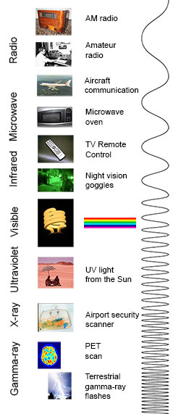
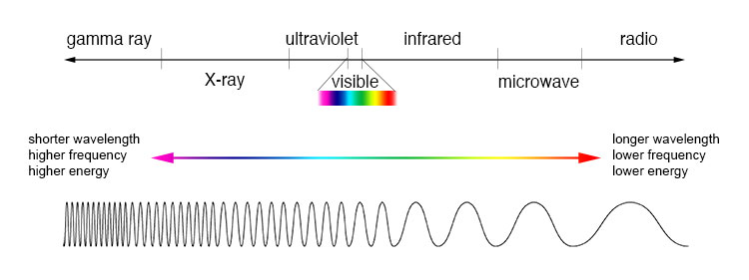
Models from NASA
Resources: https://imagine.gsfc.nasa.gov/science/toolbox/emspectrum1.html

Slide 33
Tour of the EM Spectrum (NASA)

Slide 34
Now let’s talk a little about the way you planned and carried out your investigation
Notes:
Use this slide to discuss ways to plan and carry out better investigations during the explicit reflective discussion (stage 5)

Slide 35
What were some strengths of the way you planned or carried out your investigation?
(What made it scientific?)
Notes:
Use this slide to discuss ways to plan and carry out better investigations during the explicit reflective discussion (stage 5)

Slide 36
What were some weaknesses of the way you planned and carried out your investigation?
(What made it less scientific?)
Notes:
Use this slide to discuss ways to plan and carry out better investigations during the explicit reflective discussion (stage 5)

Slide 37
What rules should we make in order to ensure that our next investigation is scientific?
Notes:
Use this slide to discuss ways to plan and carry out better investigations during the explicit reflective discussion (stage 5)

Slide 38
Now let’s talk a little about the nature of science and scientific inquiry
Notes:
Use this slide to discuss concepts related to the nature of science and scientific inquiry during the explicit reflective discussion (stage 5)

Slide 39
Scientific knowledge can change over time
Notes:
Use this slide to discuss concepts related to the nature of science and scientific inquiry during the explicit reflective discussion (stage 5)

Slide 40
Can anyone think of an example of how scientific knowledge has changed over time?
Discuss with your group and
be ready to share.
Notes:
Use this slide to discuss concepts related to the nature of science and scientific inquiry during the explicit reflective discussion (stage 5)

Slide 41
Now let’s talk a little about some important crosscutting concepts of science
Notes:
Use this slide to discuss the crosscutting concepts related to this to lab during the explicit reflective discussion (stage 5)

Slide 42
Scientists often use models to explain natural phenomena.
Notes:
Use this slide to discuss the crosscutting concepts related to this to lab during the explicit reflective discussion (stage 5)

Slide 43
Can you give me an example of some of the models we used during this investigation?
Discuss with your group and be ready to share
Notes:
Use this slide to discuss the crosscutting concepts related to this to lab during the explicit reflective discussion (stage 5)

Slide 44
Some example models from this investigation
Why are these models useful?
Notes:
Use this slide to discuss the crosscutting concepts related to this to lab during the explicit reflective discussion (stage 5)

Slide 45
Some example models from this investigation
What are some limitations of these models?
Notes:
Use this slide to discuss the crosscutting concepts related to this to lab during the explicit reflective discussion (stage 5)

Slide 46
It is important for scientists to look for patterns in the data they collect during an investigation.
Notes:
Use this slide to discuss the crosscutting concepts related to this to lab during the explicit reflective discussion (stage 5)

Slide 47
What are some examples of ways you looked for patterns during this investigation?
Discuss with your group and be ready to share
Notes:
Use this slide to discuss the crosscutting concepts related to this to lab during the explicit reflective discussion (stage 5)

Slide 48
Stage 6: Write an individual argument
You are now going to write your investigation report
Notes:
Use this slide to give students guidance as they write their draft of their investigation report (stage 6)

Slide 49
Section I: The Introduction
What were you trying to do and why?
Be sure to…
Provide a context for the investigation
Explain the task
Make the guiding question clear
You can find this information in the introduction of your lab handout
Notes:
Use this slide to give students guidance as they write their draft of their investigation report (stage 6). Be sure to give students a chance to write this section of their report before moving on to the next slide.

Slide 50
Section II: The Method
What did you do and why did you do it that way?
Be sure to explain…
How you collected your data and why you decided to do it that way
What type of data you collected and why you collected that data
How you analyzed your data and why you decided to analyze it that way
Notes:
Use this slide to give students guidance as they write their draft of their investigation report (stage 6). Be sure to give students a chance to write this section of their report before moving on to the next slide

Slide 51
Section III: The Argument
What is your argument?
Be sure to…
Provide your claim
Support your claim with evidence
Use a figure to present your evidence and reference it
Provide a justification for your evidence
Discuss other arguments
You can find all this
information on your whiteboard
Notes:
Use this slide to give students guidance as they write their draft of their investigation report (stage 6).

Slide 52
If you think the author… | Example of WEAK feedback | Example of STRONG feedback
... forgot to include something important. | Write more. | We think you forgot to include some important information, we suggest adding:
... included an important piece of information, but did not provide enough details about it. | Add more detail. | We think you need to be more specific about [X]. We suggest making the following changes:
... wrote something that was difficult to follow or confusing. | Unclear. | We did not understand what you meant by [X]. You can make your writing more clear by [Y].
... wrote something that was inaccurate. | That is not right. | We disagree with [X]. We think you should change it to [Y].
... needs to make a change to a table, graph or figure. | Fix this. | We think you need to reorganize your [X]. Here is how we would change it:
Notes:
Show this slide when the students are peer reviewing the reports (Stage 7)

Slide 53
Stage 7: Double Blind Peer Review
If you think the author… | Example of WEAK feedback | Example of STRONG feedback
... forgot to include something important. | Write more. | We think you forgot to include some important information, we suggest adding:
... included an important piece of information, but did not provide enough details about it. | Add more detail. | We think you need to be more specific about [X]. We suggest making the following changes:
... wrote something that was difficult to follow or confusing. | Unclear. | We did not understand what you meant by [X]. You can make your writing more clear by [Y].
... wrote something that was inaccurate. | That is not right. | We disagree with [X]. We think you should change it to [Y].
... needs to make a change to a table, graph or figure. | Fix this. | We think you need to reorganize your [X]. Here is how we would change it:
Stage 8: Revise and Resubmit
Notes:
Show this slide when the students are peer reviewing the reports (Stage 7)

Slide 54
Additional Optional Slides

Slide 55
Review
A | B | C | D
Do the waves above have the same – frequency? Wavelength?
Which wave has the greatest frequency?
Which wave has the longest wavelength?
What would be the velocity of each wave if each box represented the number of waves that pass in 1 second?

Slide 56
A | B | C | D
1 wave/sec or 1 Hz | 6 Hz | 2 Hz | 3 Hz
Do the waves above have the same – frequency? NO Wavelength? NO
Which wave has the greatest frequency? B
Which wave has the longest wavelength? A
What would be the frequency of each wave if each box represented the number of waves that pass in 1 second?

Slide 57
 | Electromagnetic | Mechanical
Must have a medium for these waves to travel
Sound is an example
Radiant energy from the sun is an example of this type
Sound waves this type
Gamma rays are this type
Water waves are this type
Compressional or longitudinal waves
Do not require a medium for these waves to travel
Light waves are this type
These waves can travel in a vacuum
Earthquake waves are this type
May travel through a medium, but do not require one in order to travel

Slide 58
 | Electromagnetic | Mechanical
Must have a medium for these waves to travel |  | *
Sound is an example |  | *
Radiant energy from the sun is an example of this type | *
Sound waves this type |  | *
Gamma rays are this type | *
Water waves are this type |  | *
Compressional or longitudinal waves |  | *
Do not require a medium for these waves to travel | *
Light waves are this type | *
These waves can travel in a vacuum | *
Earthquake waves are this type |  | *
May travel through a medium, but do not require one in order to travel | *

Slide 59
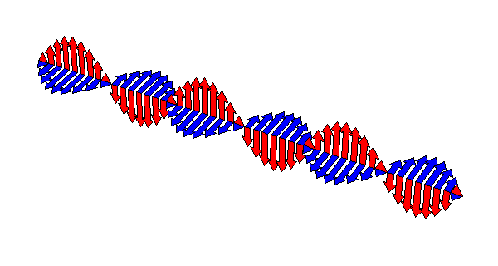
What is an Electromagnetic Wave?
A transverse wave
A wave that can travel through space or matter and consists of changing electric and magnetic fields.
Waves are produced by the vibration and movement of an electron
physicsclub.net/physletIndex/waves.html

Slide 60
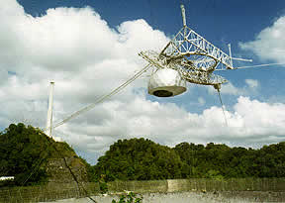
Radio Waves
Longest wavelengths of EM waves (longer than a soccer field)
Low frequency
Arecibo Observatory – Puerto Rico - the site of the world's largest single-dish radio telescope
Recognized as one of the most important national centers for research in radio astronomy
AM/FM radio waves
Cellular telephone waves
http://www.naic.edu/

Slide 61
Microwaves
Radio waves with wavelengths ranging from one meter to as short as one millimeter, or equivalently, with frequencies between 300 MHz (0.3 GHz) and 300 Ghz
Micro doesn’t mean they are small but they are smaller than radiowaves
Used in broadcasting, telecommunications

Slide 62
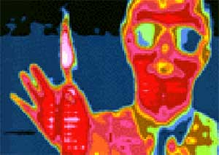
Infrared
Infrared rays are slightly longer waves than visible red light. Although we cannot see infrared, we can feel it as heat.
When heat energy is transferred by radiation, it is carried by waves of infrared.
Certain animals (like snakes) can "see" infrared light.
This allows them to find prey in the dark because thermal energy is emitted in the infrared.
Scientists have developed cameras that allow us to "see" infrared light.
"False colors" have been used to indicate temperature.
http://son.nasa.gov/tass/images/cont_emspec2.jpg

Slide 63
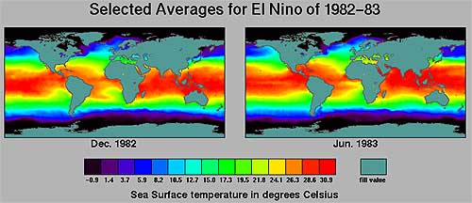
Infrared
These images of the Earth showing ocean temperatures were taken from a satellite.
Infrared imaging in weather forecasting, night vision, environmental monitoring

Slide 64
Visible Light
Electromagnetic radiation that is visible to the human eye, and is responsible for the sense of sight
Light, which is emitted and absorbed in tiny "packets" called photons, exhibits properties of both waves and particles.
Source: Wikpedia

Slide 65
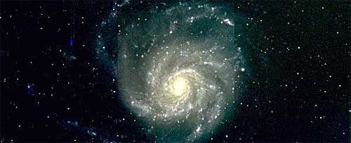
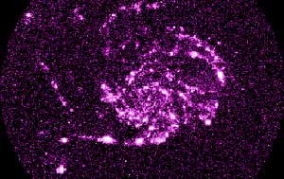
Ultraviolet
These invisible waves are slightly shorter than visible violet light and carry more energy. We wear sunglasses and sunblock to prevent damage to our eyes and skin by ultraviolet rays.
Bees are able to see “ultraviolet”
Milky way – visible light vs. ultraviolet telescope
Infoplease.com & http://son.nasa.gov/tass/images/cont_emspec2.jpg

Slide 66
X-Ray
Emitted by
Astronomical objects
X-ray machines
CAT scan machines
Older televisions
Radioactive minerals
Airport luggage scanners
Detected by
Space based X-ray detectors
X-ray film
CCD detectors

Slide 67
Gamma Rays
They have a short wavelength and a high frequency and carry large amounts of energy. They are very harmful and can cause cancer in humans and animals.
Emitted by
Radioactive materials
Exploding nuclear weapons
Solar flares
Sources
Pulsars, Black Holes, Supernovae
Detected by
Gamma detectors and astronomical satellites

Slide 68
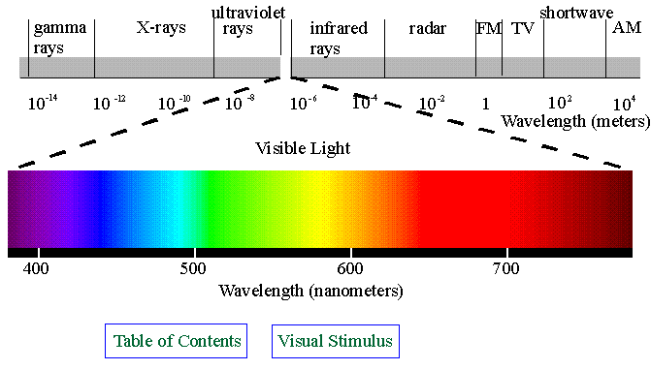
Wavelengths
http://www.yorku.ca/eye/spectrum.gif

Slide 69
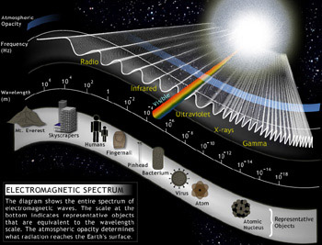
~Size of the Wavelengths
SUN
Mt. Everest
Skyscrapers
Humans
Fingernail
Pinhead
Bacterium
Virus
Atom
Atomic Nucleus
http://ds9.ssl.berkeley.edu/LWS_GEMS/2/images_2/ems350.jpg

Slide 70
Explore: Stadium Wave
http://www.glenbrook.k12.il.us/GBSSCI/PHYS/Class/waves/u10l1c.html#emmech
Doing the wave as a class – arrange seats in a circle with class members sitting – simulate a wave at a sports event
A noticeable ripple is produced which travels around the circular stadium or back and forth across a section of bleachers.
The observable ripple results when a group of enthusiastic fans rise up from their seats, swing their arms up high, and then sit back down.
The wave is passed from row to row as each individual member of the row becomes temporarily displaced out of their seat, only to return to it as the wave passes by.
The medium through which the stadium wave travels is the fans who are in the stadium.
And in the case of a stadium wave, the particles or interacting parts of the medium are the fans in the stadium.

Slide 71
A Wave Transports Energy and Not Matter
When a wave is present in a medium (that is, when there is a disturbance moving through a medium), the individual particles of the medium are only temporarily displaced from their rest position.
There is always a force acting upon the particles which restores them to their original position. In a slinky wave, each coil of the slinky ultimately returns to its original position.
In a water wave, each molecule of the water ultimately returns to its original position.
In a stadium wave, each fan in the bleacher ultimately returns to its original position.
A wave is said to involve the movement of a disturbance without the movement of matter.
The particles of the medium (water molecules, slinky coils, stadium fans) simply vibrate about a fixed position as the pattern of the disturbance moves from one location to another location.

