Slide 1
Unit 2:
Force & Motion
Balanced and Unbalanced Forces
Notes:
Benchmark Clarifications
Students will describe the relationship among mass, force, and motion.
Students will identify and/or describe that an object in motion always changes its position and may change its direction.
Students will describe that the speed of an object is determined by the distance an object travels and the time it takes the object to travel that distance.
Students will describe that objects can move at different speeds.
Content Limits
Items assessing relationship between mass, force, and motion are limited to a conceptual understanding. Items will not involve mathematical calculations or formulas.
Items will address a conceptual understanding of speed and not require mathematical computations.
Items may require the identification of the direction of motion but not the magnitude of motion.
Items may refer to balanced forces and/or unbalanced forces but not net force.
Items assessing forces applied to objects of different masses are limited to pushes, pulls, and friction.

Slide 2
Board configuration
Essential Question:
What is the difference between balanced and unbalanced forces?
Words to Know:
Sir Isaac Newton
Motion
Force (Balanced & Unbalanced force)
Acceleration
Newton’s Law of Motion
Inertia
Friction
Gravity

Slide 3
What is Force?
A force is a push or pull on an object
Every force has a STRENGTH
Every force has a DIRECTION
Forces work in pairs, every force has an opposing force working in the opposite direction
Notes:
Explain to students that force is a push or pull.

Slide 4
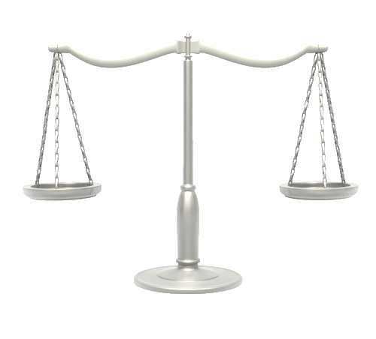
How do forces affect objects?
More than one force usually acts on an object at the same time
Sometimes forces are applied in the same direction
Sometimes forces are applied in different directions
________________ forces produce no change in the motion of an object
________________ forces produce a change in the motion of an object
Notes:
Participants will compare unpacking the benchmark before using the Item Specs to afterwards when they used Item Specs.

Slide 5
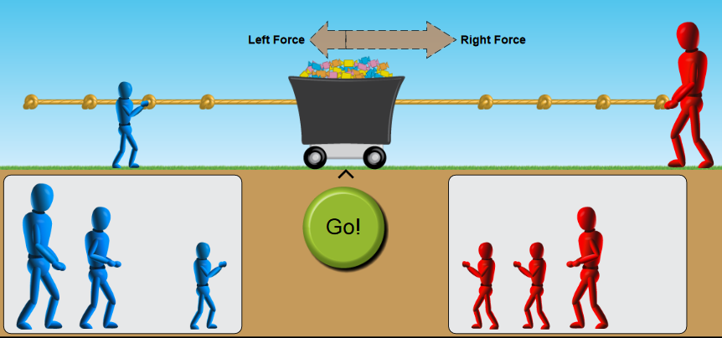
Balanced Forces
Balanced forces are opposing forces of the same strength acting on an object.
Balanced forces result in NO CHANGE in the motion of an object.
Think about a game of tug-of-war. If there is equal pull on both sides, then each side is balanced and neither side will fall forward!
Click on image or link and demonstrate balanced forces through online simulation
http://phet.colorado.edu/sims/html/forces-and-motion-basics/latest/forces-and-motion-basics_en.html
Notes:
It is important to note that balanced forces mean NO CHANGE in motion-it does not mean an object must be still.

Slide 6
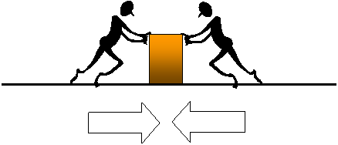
Balanced Forces
Balanced forces do not cause a change in the motion of objects
Notes:
(Insert Teacher instructional notes)

Slide 7
Unbalanced Forces
Unbalanced forces are opposing forces of unequal strength acting on an object.
Unbalanced forces always CAUSE A CHANGE in motion.
Think about a game of tug-of-war. If there is an unequal pull, then there are unbalanced forces and one side will fall forward!
Click on image or link and demonstrate balanced forces through online simulation
http://phet.colorado.edu/sims/html/forces-and-motion-basics/latest/forces-and-motion-basics_en.html
Notes:
It is important to note that balanced forces mean NO CHANGE in motion-it does not mean an object must be still.

Slide 8
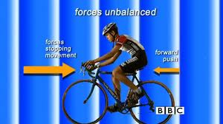
Unbalanced Forces A bicycle rider
When you ride a bike the force of the friction of the tires against the road is greater than the opposing force of friction with the air. The bicycle moves forward. This is an example of unbalanced forces.
http://www.bbc.co.uk/learningzone/clips/balanced-and-unbalanced-forces/10592.html

Slide 9
Accountable Talk
SHARE
How do you know when forces are balanced? unbalanced?
Notes:
Have teachers turn and talk and answer the question What is rigor?
Have teachers to chart it. They will come back to it later and revamp based on training module.

Slide 10
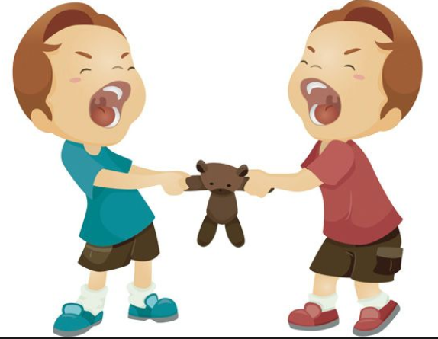
Net Force
A net force is the sum of all forces acting on an object.
Net force is measured in newtons (N).
A net force is capable of accelerating a mass.
Notes:
Acceleration means a change in motion. Acceleration can mean a change in speed (faster/slower) or a change in direction.

Slide 11
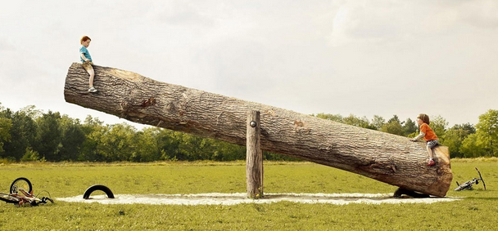
When net forces on each side are not equal, the object moves in the direction of the greater force.
Example: The force exerted by Linus, on the right, is greater than the force exerted by Charlie Brown, on the left. Therefore the net force is greater on the right and the see-saw moves in the direction of the greater net force.
60 N
100 N

Slide 12
Aniya places a book on her desk, the book does not move.
Explain net force of the book and desk. What is your evidence?
Notes:
When the net force equals zero (by having all forces acting on an object equal and opposite) there is no change in the motion of an object. Then the net force is not zero (by having forces of unequal strength act on an object) then there will be a change in motion of the object. Changes in motion can include: start, stop, increased speed, decreased speed, change in direction, this is also called acceleration.

Slide 13
Guided Practice
1. A 3 Newton force is applied to the left side of a scale, and a 7 Newton force is applied to the right side of a scale. Would this be an example of a balanced force or unbalanced force?

Slide 14
Guided Practice
Unbalanced Force

Slide 15
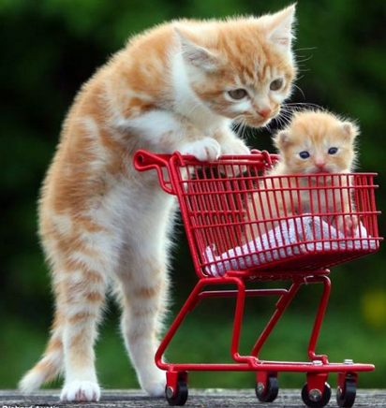
Guided Practice
2.
A kitty cat applies an unbalanced force to a shopping cart. Which of the following things would happen?
The shopping cart will start to move.
The shopping cart does
not move.
The shopping cart gets smaller.
The shopping cart gets bigger.
Notes:
Unbalanced forces always result in a change in motion

Slide 16
A
Unbalanced forces always cause a change in motion.

Slide 17
3.
Marlon's packed up clothes and toys that he no longer played with and wore. He placed the packed boxes in the garage. Which box will require the most force to move?
10 kg
14 kg
18 kg
20 kg
A B C D

Slide 18
D
The more mass the more force required to move object.

Slide 19
4. In a tug of war contest, one person pulls with a force of 5 Newtons. Another person on the same team pulls with a force of 6 Newtons. In order for the force of the rope to be balanced, what force would the other team be pulling with?
2 Newtons
5 Newtons
8 Newtons
11 Newtons

Slide 20
D
For forces to be balanced they must be equal and opposite. If one side pulls with a combined force of 11 Newtons, the other side would also need to pull with a combined force of 11 Newtons in order for the forces to be balanced.

Slide 21
Summary Question
Turn to your shoulder partner and give examples of balanced and unbalanced forces. Switch roles.
Notes:
Possible answers: Balanced is when the forces on each side of an object are equal and there is no change in motion. Examples may include anything that is holding still or anything that continues in a straight line at an unwavering speed (such as a probe in deep space). Unbalanced is when the forces are unequal with a resulting change in motion. Examples can include anything that starts/stops/goes faster/goes slower/ changes direction.

Slide 22
Independent Practice
When an object is at rest, which of the following is true?
There are no forces acting on it.
There are forces acting on it, but these forces are balanced.
There is just one force acting on it, which is gravity.
The forces acting on it are unequal in strength

Slide 23
Independent Practice
A girl is standing still on a tennis court, with her racket resting on her shoulder. Her tennis partner just hit a ball to her. Which object is showing the effect of an unbalanced force?
The girl standing still
The tennis racket
The ball
The ground

Slide 24
Independent Practice
3. Aniya built a toy airplane. She was investigating what would help her plane fly faster. Which statement best explains what Aniya could do to make the plane fly faster?
Fly the plane against the wind.
Fly the plane with the wind.
Fly plane in an upward angle.
There is not way to make the plane fly faster.

Slide 25
b) There are forces acting on it, but these forces are
balanced.
c) The ball
3. a) Fly the plane with the wind.

Slide 26
Exit Slip
Answer the Essential Question
Essential Question:
When are forces balanced or
unbalanced? Give a real world example of each.

