Slide 1
Electromagnetic Waves:
Mediums
Essential Question: How are the characteristics of electromagnetic waves affected by medium?
Write the essential question on the top right of the handout and your name on the right side.
Notes:
Instructional Approach(s): The teacher should introduce the essential question and the standard that aligns to the essential question

Slide 2
Let’s Review
Electromagnetic Waves
Waves that DO NOT NEED matter
(medium) to transfer energy
  Examples: radiation, TV & radio waves,
  X-rays, microwaves, lasers, energy from
  the sun, visible light
  Electromagnetic waves are considered transverse waves because they have similar characteristics. They have a crest, trough, wavelength, and amplitude
Notes:
Instructional Approach(s): The teacher should present the information on the slide while the students record the important information on their notes.

Slide 3
How are Electromagnetic
Waves made?
An electrically charged particle vibrates.
When the particle vibrates, the electric field vibrates.
The vibrating electric field creates a vibrating magnetic field.
The vibration of an electric field and a magnetic field together produces an Electromagnetic (EM) Wave that carries energy
Notes:
Instructional Approach(s): The teacher should present the information on the slide while the students record the important information on their notes.

Slide 4
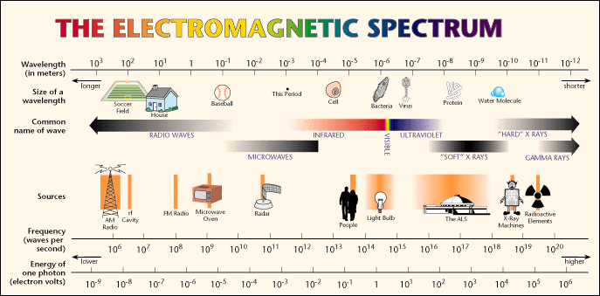
Electromagnetic Spectrum
The Electromagnetic Spectrum illustrates the range of wavelengths and frequencies of electromagnetic waves.
Notice that some kinds of waves have overlapping ranges
Notes:
Instructional Approach(s): The teacher should present the information on the slide.

Slide 5
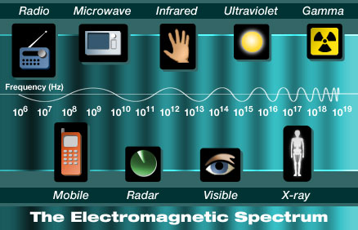
Notice the changes in the frequency of the wavelengths in the spectrum
Notes:
Instructional Approach(s): The teacher should present the information on the slide.

Slide 6
Distributed Summarizing
With a partner, discuss the following questions:
How is an electromagnetic wave different from a mechanical wave (sound)?
Name some examples of electromagnetic waves. Compare the wavelength and frequency of your examples (you may need to use electromagnetic spectrum diagram)
Notes:
Instructional Approach(s): Think-pair-share. The teacher should walk among the students and listen to ensure mastery and understanding.

Slide 7
Changes in Mediums
Waves do not just stop when they reach the end of a medium or when they meet an obstacle in the path.
These behaviors were first introduced in the lesson on sound. They include: absorption, reflection, diffraction, and refraction.
We will be examining these behaviors in regards to light waves
Notes:
Instructional Approach(s): The teacher should present the information on the slide while the students record the important information on their notes.

Slide 8
Changes in Mediums: Light Waves
When light waves strike an object, some of the waves are absorbed by the object, some are reflected by it, and some might pass through it (transmitted).
What happens to light when it strikes the object depends on the material of the object.
Notes:
Instructional Approach(s): The teacher should present the information on the slide while the students record the important information on their notes.

Slide 9
Changes in Mediums
Absorption of Light Waves
Absorption is the transfer of light energy to matter
Absorbed light can make things feel warmer
Think of examples of light absorption that you have experienced
Notes:
Instructional Approach(s): The teacher should present the information on the slide while the students record the important information on their notes.

Slide 10
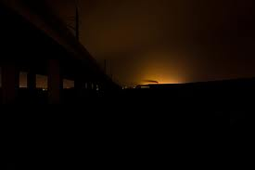
When a beam of light shines through the air, particles in the air absorb some of the energy from the light. As a result, the beam of light becomes dim. The farther the light travels from its source, the more it is absorbed by particles, and the dimmer it becomes.
Notes:
Instructional Approach(s): The teacher should present the information on the slide provide examples of light absorption.

Slide 11
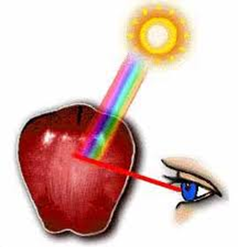
Changes in Mediums:
Absorption of Light Waves
Absorption will be discussed more in the next essential question on how light is detected by the human eye.
Notes:
Instructional Approach(s): The teacher should present the information on the slide.

Slide 12
Changes in Mediums
Reflection of Light Waves
Reflection occurs when a wave strikes an object or surface and bounces off.
Light waves reflecting off an object allow you to see that object.
Light reflected from any surface always follows a simple rule: the angle with which the ray of light hits the surface is the same with which the ray of light will be reflected (Law of Reflection)
Notes:
Instructional Approach(s): The teacher should present the information on the slide while the students record the important information on their notes.

Slide 13
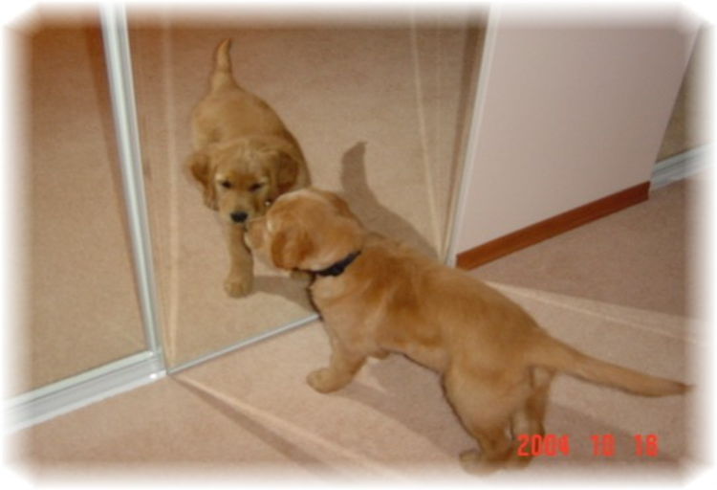
If the surface is smooth and even, the reflection will be clear.
Notes:
Instructional Approach(s): The teacher should present the information on the slide while the students record the important information on their notes.

Slide 14
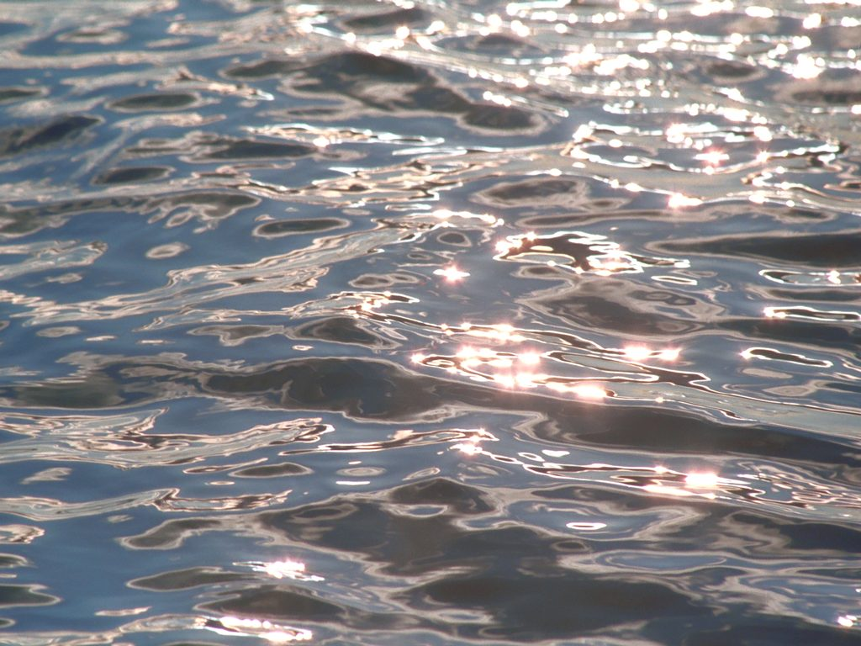

If the surface is uneven, like ripples in a pond, the light is reflected in many directions and the image is not clear.
Notes:
Instructional Approach(s): The teacher should present the information on the slide while the students record the important information on their notes.

Slide 15
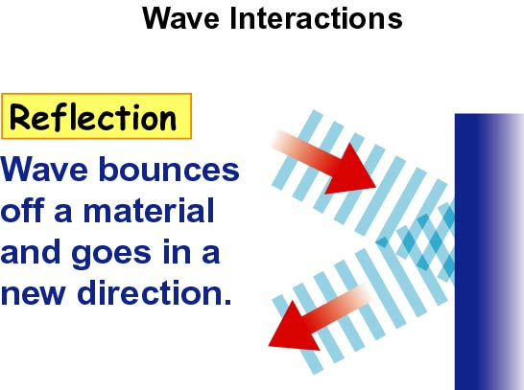
Notes:
Instructional Approach(s): The teacher should present the illustration on the slide to reinforce reflection.

Slide 16
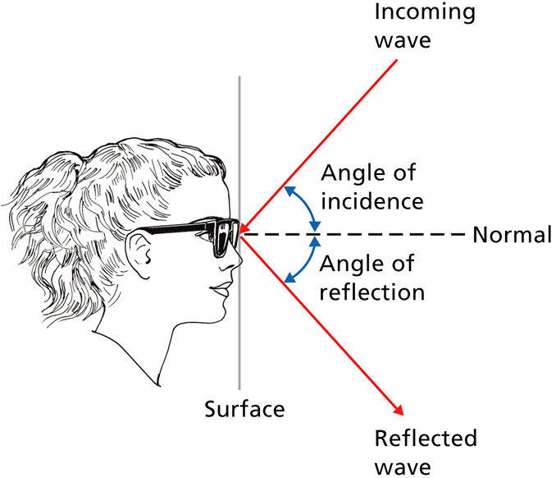
Notice: the angle with which the ray of light hits the surface is the same with which the ray of light is reflected
Notes:
Instructional Approach(s): The teacher should present the illustration on the slide to reinforce reflection.

Slide 17
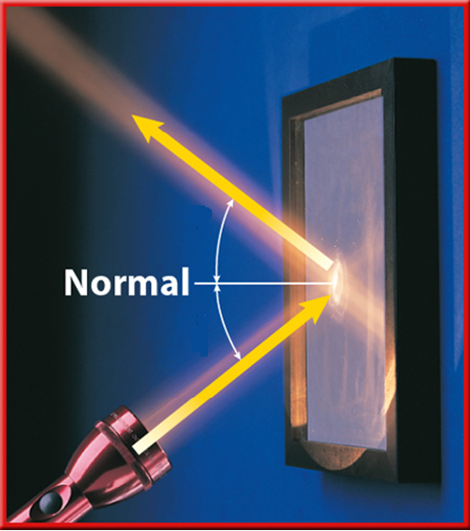
Reflected Beam
Angle of Reflection
Angle of Incidence
Incident Beam
Notes:
Instructional Approach(s): The teacher should present the illustration on the slide to reinforce reflection.

Slide 18
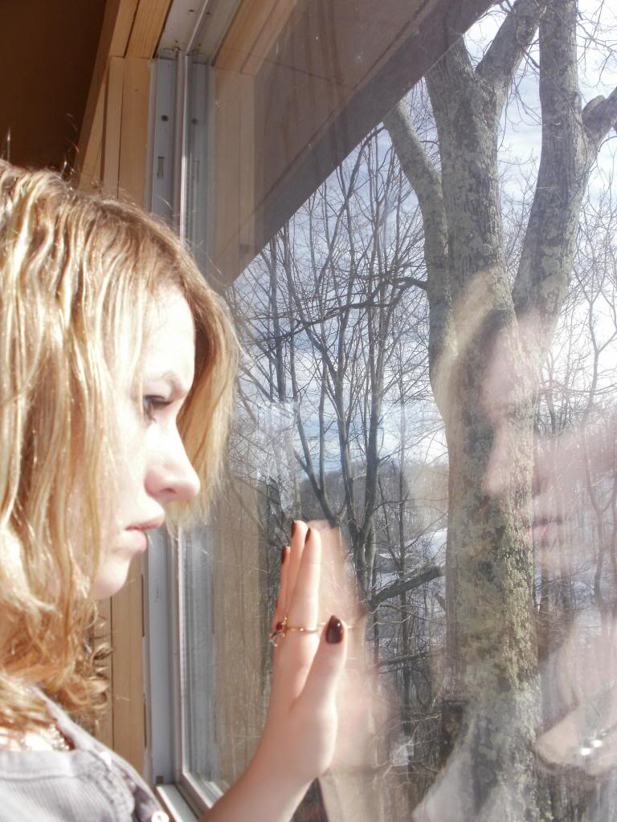
Distributed Summarizing:
Look at the picture to the right. Discuss the following questions with a partner.
How is the girl able to see the trees outside the window?
How is the girl able to see herself on the glass? What is this called?
What does the girl feel when she touches the glass? Why?
Notes:
Instructional Approach(s): The teacher should present questions to the class or one student. Click on the next slide to show the correct answers.

Slide 19
You can see objects outside because light is transmitted through the glass
You can see the glass and your reflection in it because light is reflected off the glass
The glass feels warm when you touch it because some of the light is absorbed by the glass

Slide 20
Changes in Mediums
Diffraction of Light Waves
Diffraction is the bending of waves around a barrier.
The amount a wave diffracts depends on its wavelength and the size of the barrier or the opening.
The greatest amount of diffraction occurs when the barrier or opening is the same size or smaller than the wavelength
Notes:
Instructional Approach(s): The teacher should present the information on the slide while the students record the important information on their notes.

Slide 21
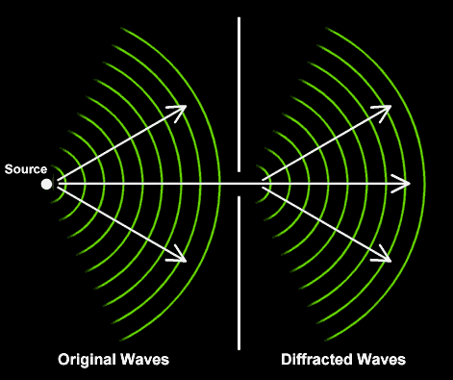
Diffraction
http://library.thinkquest.org/19537/Physics6.html
Notes:
Instructional Approach(s): The teacher should present the illustration on the slide to reinforce diffraction.

Slide 22
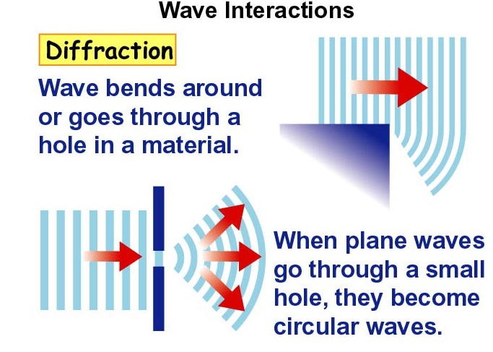
Notes:
Instructional Approach(s): The teacher should present the illustration on the slide to reinforce diffraction.

Slide 23
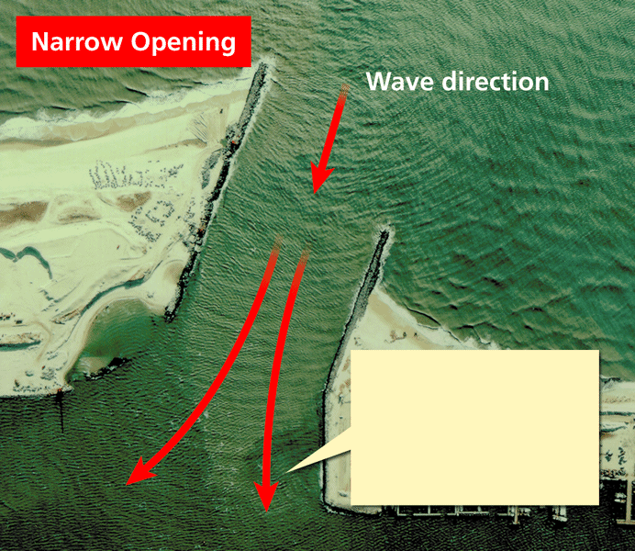
Notes:
Instructional Approach(s): The teacher should present the illustration on the slide to reinforce diffraction.

Slide 24
Changes in Mediums
Diffraction of Light Waves
Light waves have very small wavelengths; therefore, light waves cannot diffract very much around large obstacles, such as buildings. Thus, you cannot see around corners (but you can hear sound around corners)
http://www.acoustics.salford.ac.uk/feschools/waves/diffract.htm
Notes:
Instructional Approach(s): The teacher should present the information.

Slide 25
Changes in Mediums
Refraction of Light Waves
Refraction is the bending of a wave as it moves from one medium into another
The speed and wavelength of a wave changes during refraction (velocity changes)
Notes:
Instructional Approach(s): The teacher should present the information on the slide while the students record the important information on their notes.

Slide 26
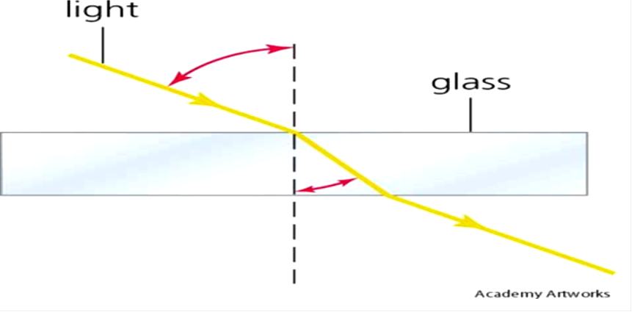
The speed of light varies depending on the material through which the waves are traveling.
When a wave enters a new material at an angle, the part of the wave that enters first begins traveling at a different speed from that of the rest of the wave.
Notes:
Instructional Approach(s): The teacher should present the illustration on the slide to reinforce rarefaction.

Slide 27
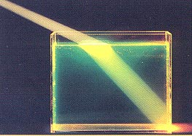
Refraction is what gives the illusion of a bent straw or spoon in a clear glass of water.
Light waves travel faster in air than in water, so as it passes through the water, it slows down and appears to bend.
Notes:
Instructional Approach(s): The teacher should present the illustration on the slide to reinforce rarefaction.

Slide 28
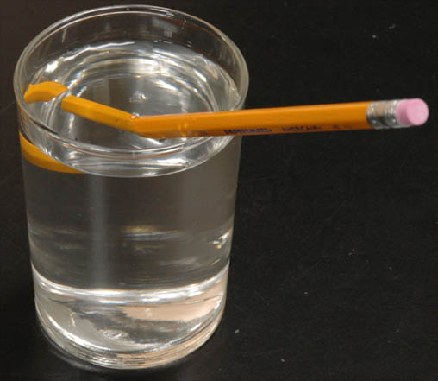
Refraction at the water surface gives the "broken pencil" effect.
Submerged objects always appear to be shallower than they are because the light from them changes angle at the surface, bending downward toward the water.
Notes:
Instructional Approach(s): The teacher should present the illustration on the slide to reinforce rarefaction.

Slide 29

As light passes through a prism, such as a crystal or a drop of water, refraction causes light to bend and separate into many colors and produces a rainbow.
Notes:
Instructional Approach(s): The teacher should present the illustration on the slide to reinforce rarefaction.

Slide 30
Distributed Summarizing
Explain the difference between Diffraction and Refraction.
Give examples of both.
How is refraction an optical illusion?
Notes:
Instructional Approach(s): Think-pair-share. The teacher should walk among the students and listen to ensure mastery and understanding.

